Slide 1
Chapter 16 Generic Collections
Java How to Program, 11/e

Slide 2
Course Objectives
Understand and implement various data structures (List, Trees, etc.).
Utilize different sort and search algorithms.

Slide 3
Chapter Objectives
Describe what collections are.
Explain the class Arrays for array manipulations.
Describe the type-wrapper classes that enable programs to process primitive data values as objects.
Describe autoboxing and auto-unboxing.
Explain the prebuilt generic data structures from the collections framework.
Explain various algorithms of the Collections class.
Explain iterators to “walk through” a collection.

Slide 4
16.2 Collections Overview
A collection is a data structure—actually, an object—that can hold references to other objects.
Usually, collections contain references to objects of any type that has the is-a relationship with the type stored in the collection.
Figure 16.1 lists some of the collections framework interfaces.
Package java.util.

Slide 5
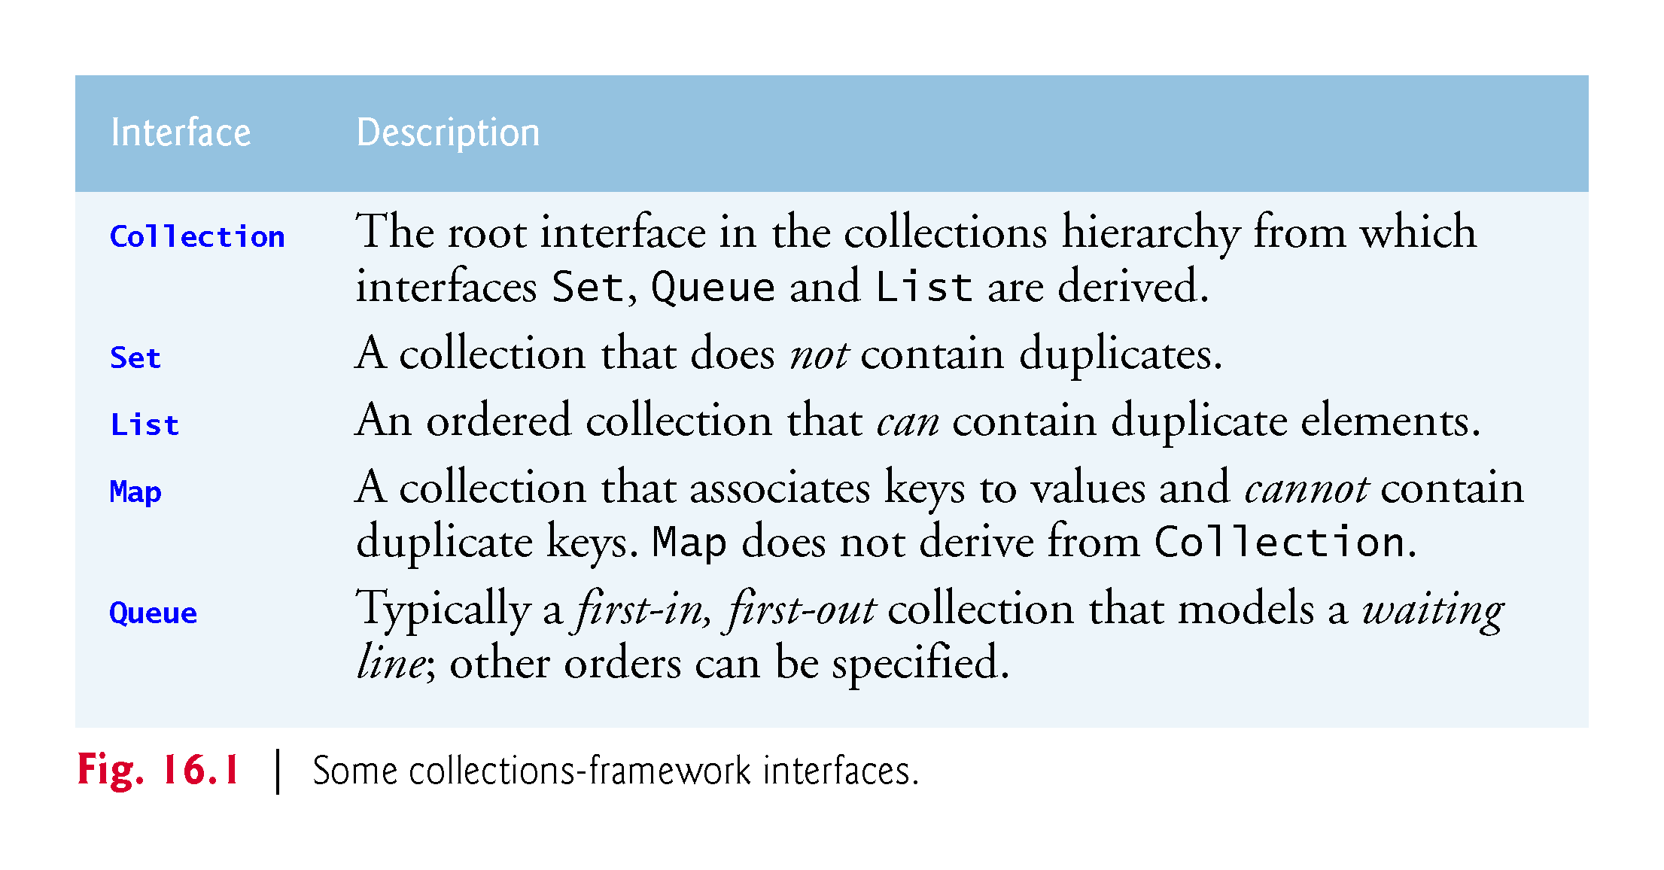

Slide 6
16.3 Type-Wrapper Classes
Each primitive type has a corresponding type-wrapper class (in package java.lang).
Boolean, Byte, Character, Double, Float, Integer, Long and Short.
Each type-wrapper class enables you to manipulate primitive-type values as objects.
Collections cannot manipulate variables of primitive types.
They can manipulate objects of the type-wrapper classes, because every class ultimately derives from Object.

Slide 7
16.3 Type-Wrapper Classes (Cont.)
Each of the numeric type-wrapper classes—Byte, Short, Integer, Long, Float and Double—extends class Number.
The type-wrapper classes are final classes, so you cannot extend them.
Primitive types do not have methods, so the methods related to a primitive type are located in the corresponding type-wrapper class.

Slide 8
16.4 Autoboxing and Auto-Unboxing
A boxing conversion converts a value of a primitive type to an object of the corresponding type-wrapper class.
An unboxing conversion converts an object of a type-wrapper class to a value of the corresponding primitive type.
These conversions are performed automatically—called autoboxing and auto-unboxing.
Example:
// create integerArray Integer[] integerArray = new Integer[5]; // assign Integer 10 to integerArray[ 0 ] integerArray[0] = 10; // get int value of Integer int value = integerArray[0];

Slide 9
16.5 Interface Collection and Class Collections
Interface Collection contains bulk operations for adding, clearing and comparing objects in a collection.
A Collection can be converted to an array.
Interface Collection provides a method that returns an Iterator object, which allows a program to walk through the collection and remove elements from the collection during the iteration.
Class Collections provides static methods that search, sort and perform other operations on collections.

Slide 10
16.6 Lists
A List (sometimes called a sequence) is an ordered Collection that can contain duplicate elements.
List indices are zero based.
In addition to the methods inherited from Collection, List provides methods for manipulating elements via their indices, manipulating a specified range of elements, searching for elements and obtaining a ListIterator to access the elements.
Interface List is implemented by several classes, including ArrayList, LinkedList and Vector.
Autoboxing occurs when you add primitive-type values to objects of these classes, because they store only references to objects.

Slide 11
16.6 Lists (Cont.)
Class ArrayList and Vector are resizable-array implementations of List.
Inserting an element between existing elements of an ArrayList or Vector is an inefficient operation.
A LinkedList enables efficient insertion (or removal) of elements in the middle of a collection, but is much less efficient than an ArrayList for jumping to a specific element in the collection.
We discuss the architecture of linked lists in Chapter 21.
The primary difference between ArrayList and Vector is that operations on Vectors are synchronized by default, whereas those on ArrayLists are not.
Unsynchronized collections provide better performance than synchronized ones.
For this reason, ArrayList is typically preferred over Vector in programs that do not share a collection among threads.

Slide 12
16.6.1 ArrayList and Iterator
List method add adds an item to the end of a list.
List method size returnS the number of elements.
List method get retrieves an individual element’s value from the specified index.
Collection method iterator gets an Iterator for a Collection.
Iterator- method hasNext determines whether there are more elements to iterate through.
Returns true if another element exists and false otherwise.
Iterator method next obtains a reference to the next element.
Collection method contains determine whether a Collection contains a specified element.
Iterator method remove removes the current element from a Collection.

Slide 13
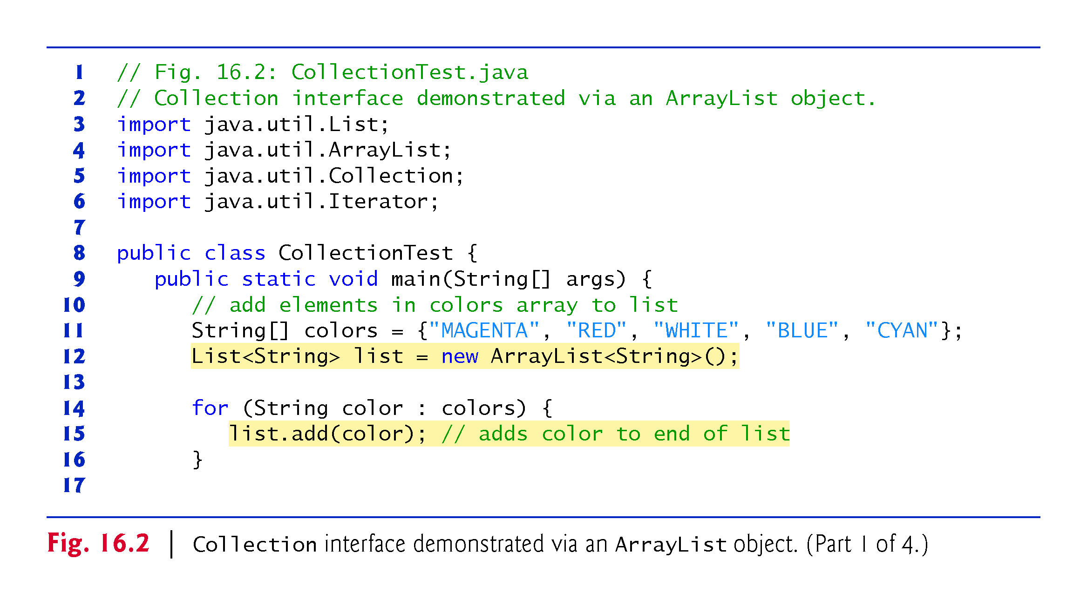

Slide 14
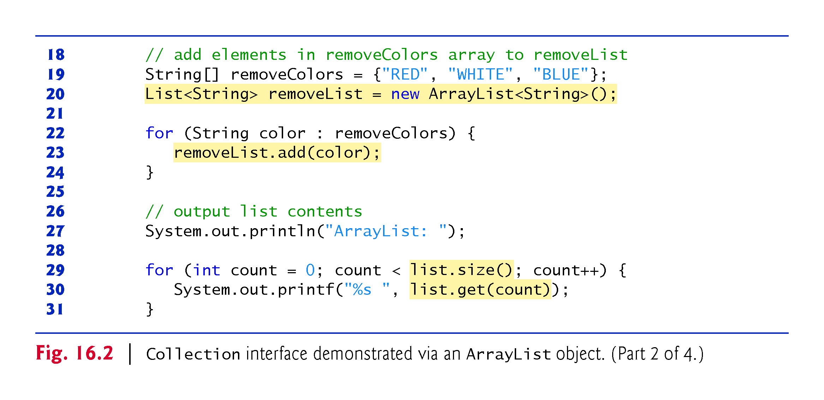

Slide 15
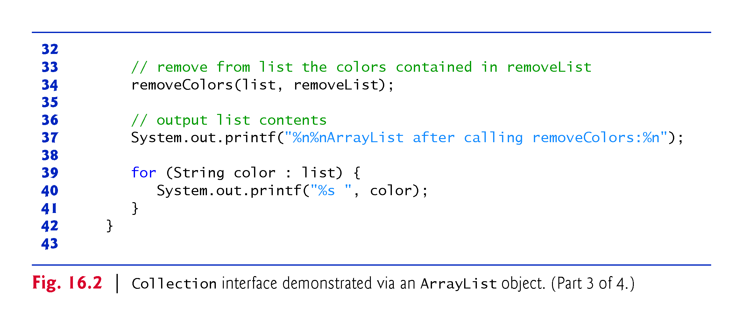

Slide 16
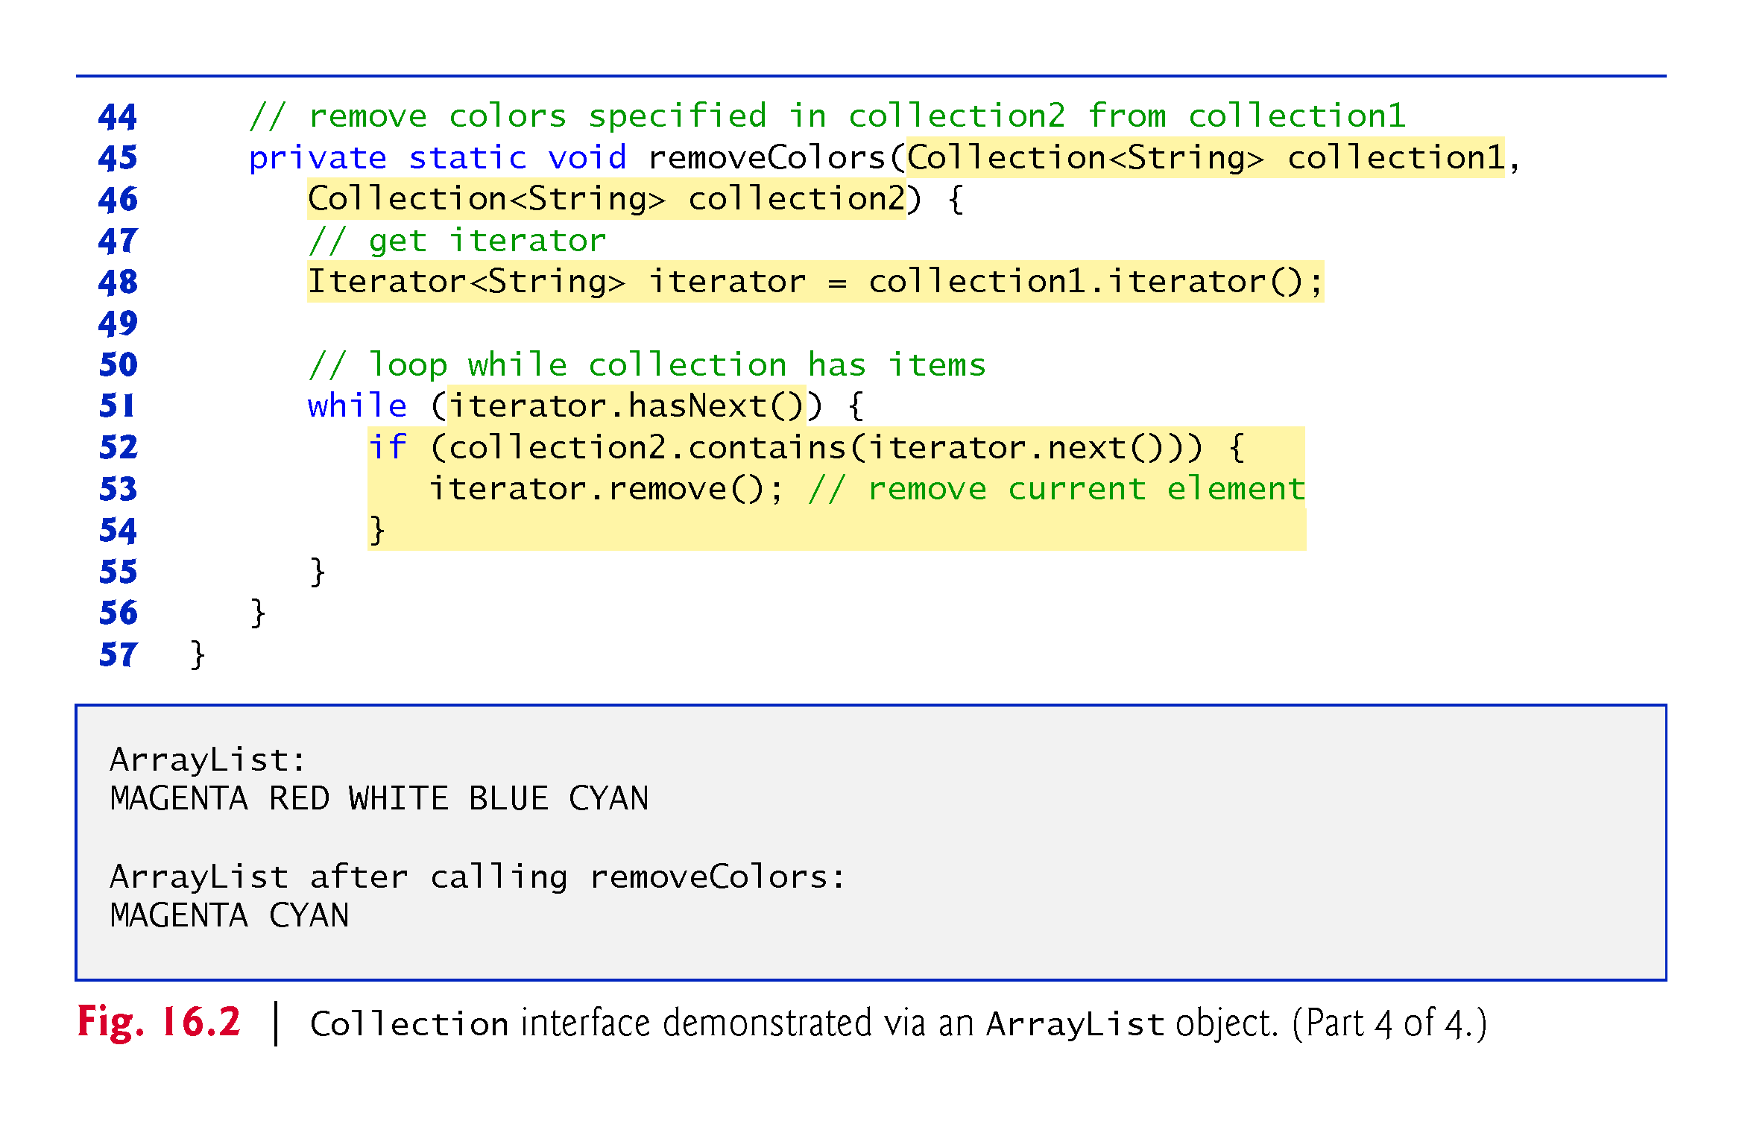

Slide 17
16.6.1 ArrayList and Iterator (Cont.)
Type Inference with the <> Notation
Lines 12 and 20 specify the type stored in the ArrayList (that is, String) on the left and right sides of the initialization statements.
Java SE 7 introduced type inferencing with the <> notation—known as the diamond notation—in statements that declare and create generic type variables and objects. For example, line 14 can be written as:
List<String> list = new ArrayList<>();
Java uses the type in angle brackets on the left of the declaration (that is, String) as the type stored in the ArrayList created on the right side of the declaration.

Slide 18
16.6.2 LinkedList
List method addAll appends all elements of a collection to the end of a List.
List method listIterator gets A List’s bidirectional iterator.
String method toUpperCase gets an uppercase version of a String.
List-Iterator method set replaces the current element to which the iterator refers with the specified object.
String method toLowerCase returns a lowercase version of a String.
List method subList obtaina a portion of a List.
This is a so-called range-view method, which enables the program to view a portion of the list.

Slide 19
16.6.2 LinkedList (Cont.)
List method clear remove the elements of a List.
List method size returns the number of items in the List.
ListIterator method hasPrevious determines whether there are more elements while traversing the list backward.
ListIterator method previous gets the previous element from the list.

Slide 20
16.6.2 LinkedList (Cont.)
Class Arrays provides static method asList to view an array as a List collection.
A List view allows you to manipulate the array as if it were a list.
This is useful for adding the elements in an array to a collection and for sorting array elements.
Any modifications made through the List view change the array, and any modifications made to the array change the List view.
The only operation permitted on the view returned by asList is set, which changes the value of the view and the backing array.
Any other attempts to change the view result in an UnsupportedOperationException.
List method toArray gets an array from a List collection.

Slide 21
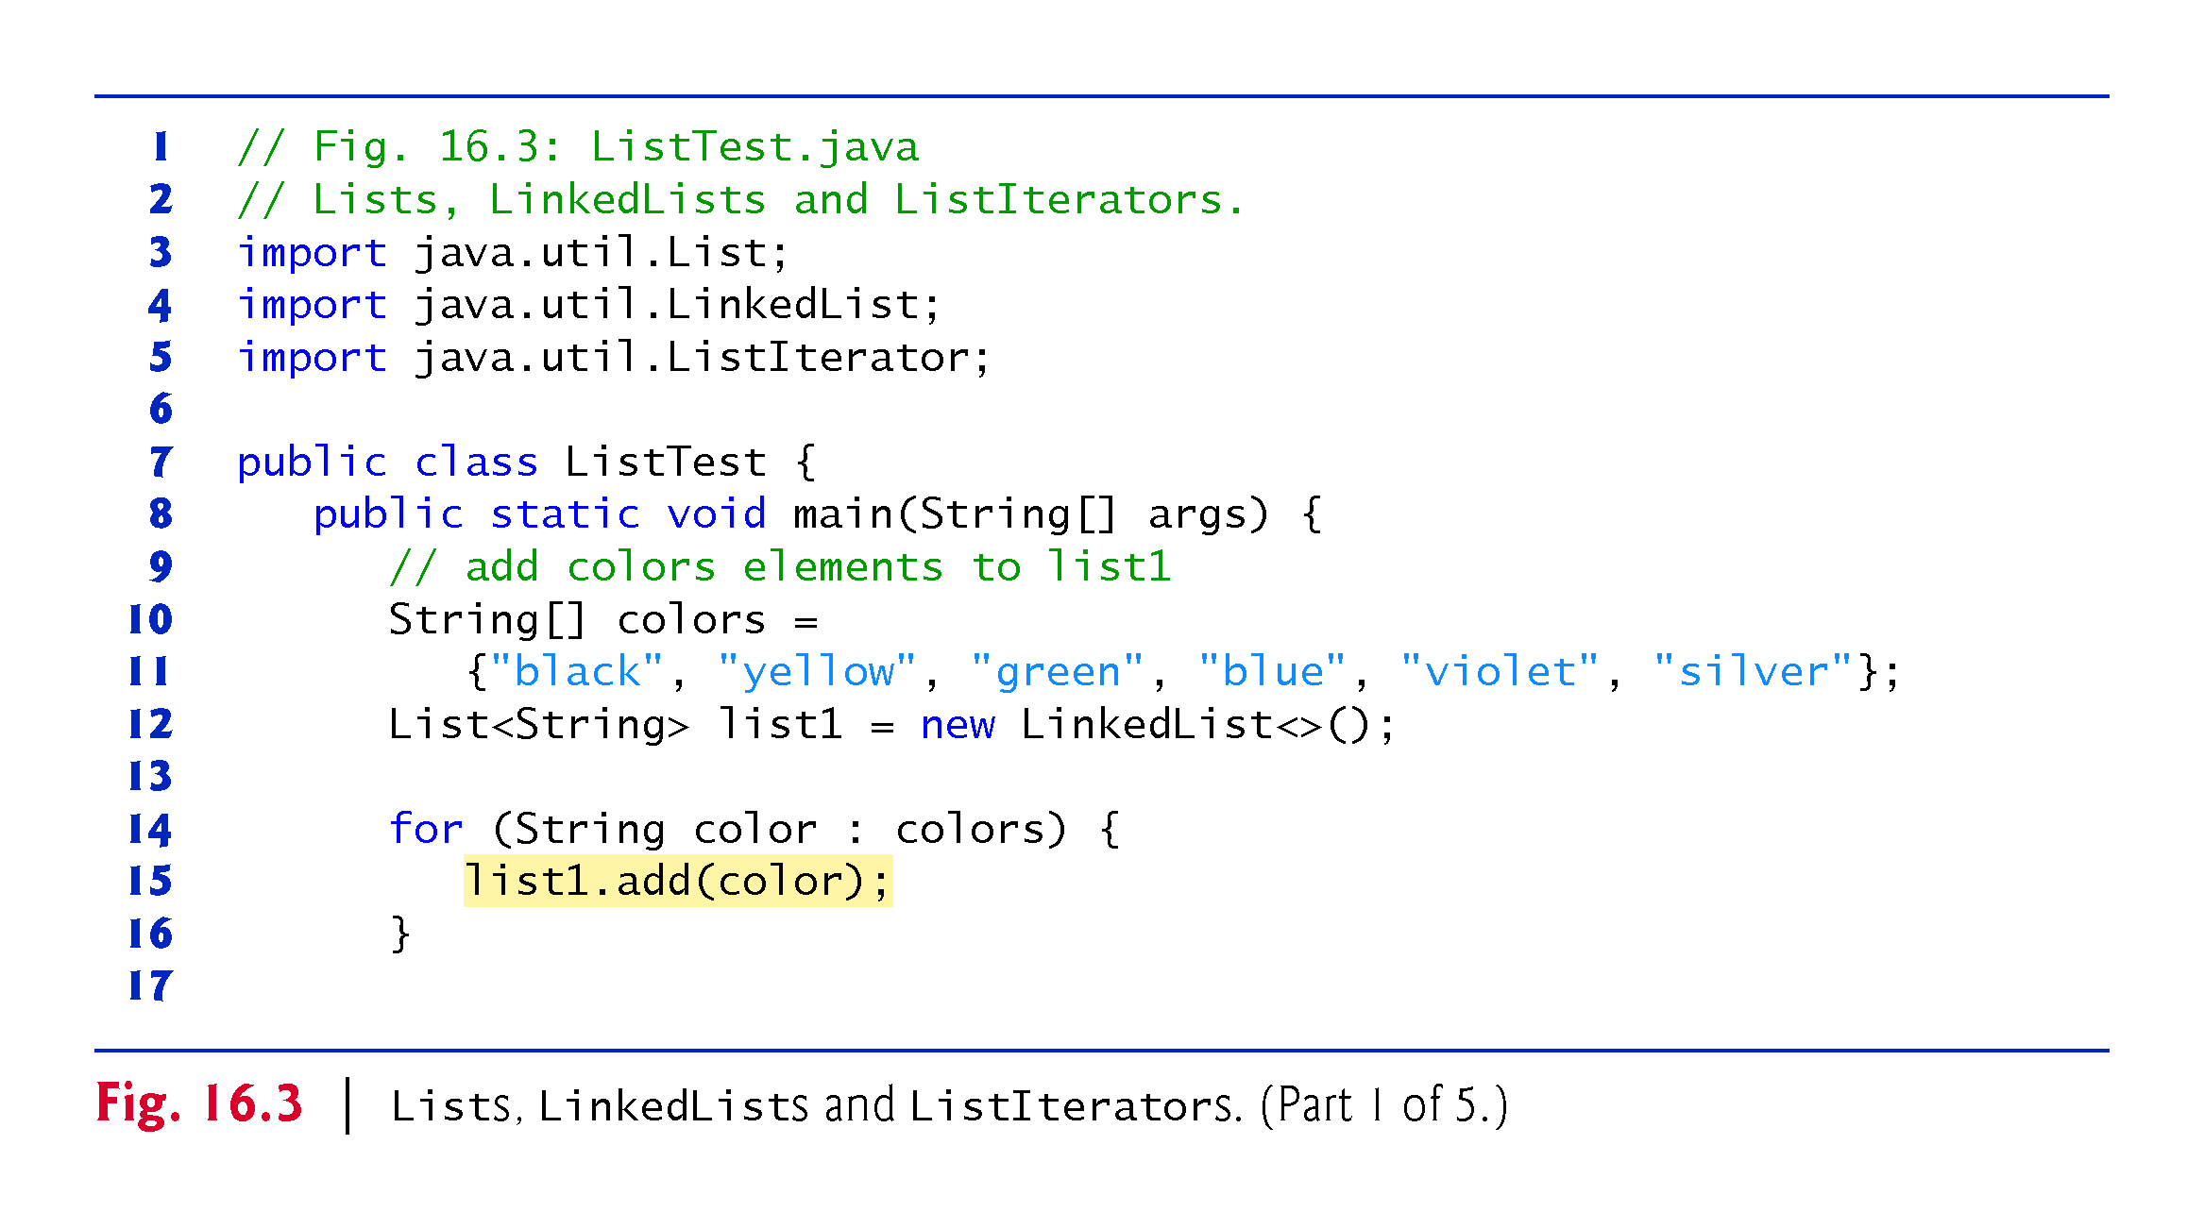

Slide 22
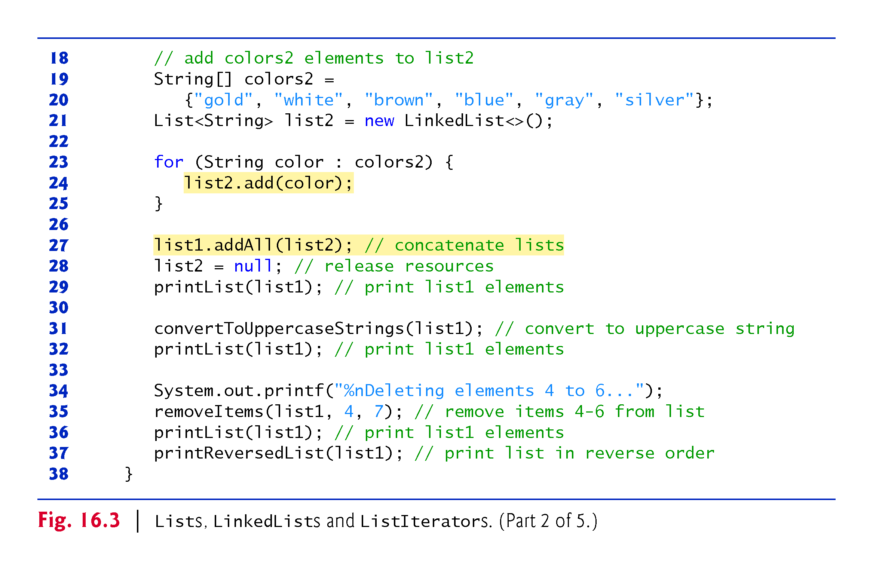

Slide 23
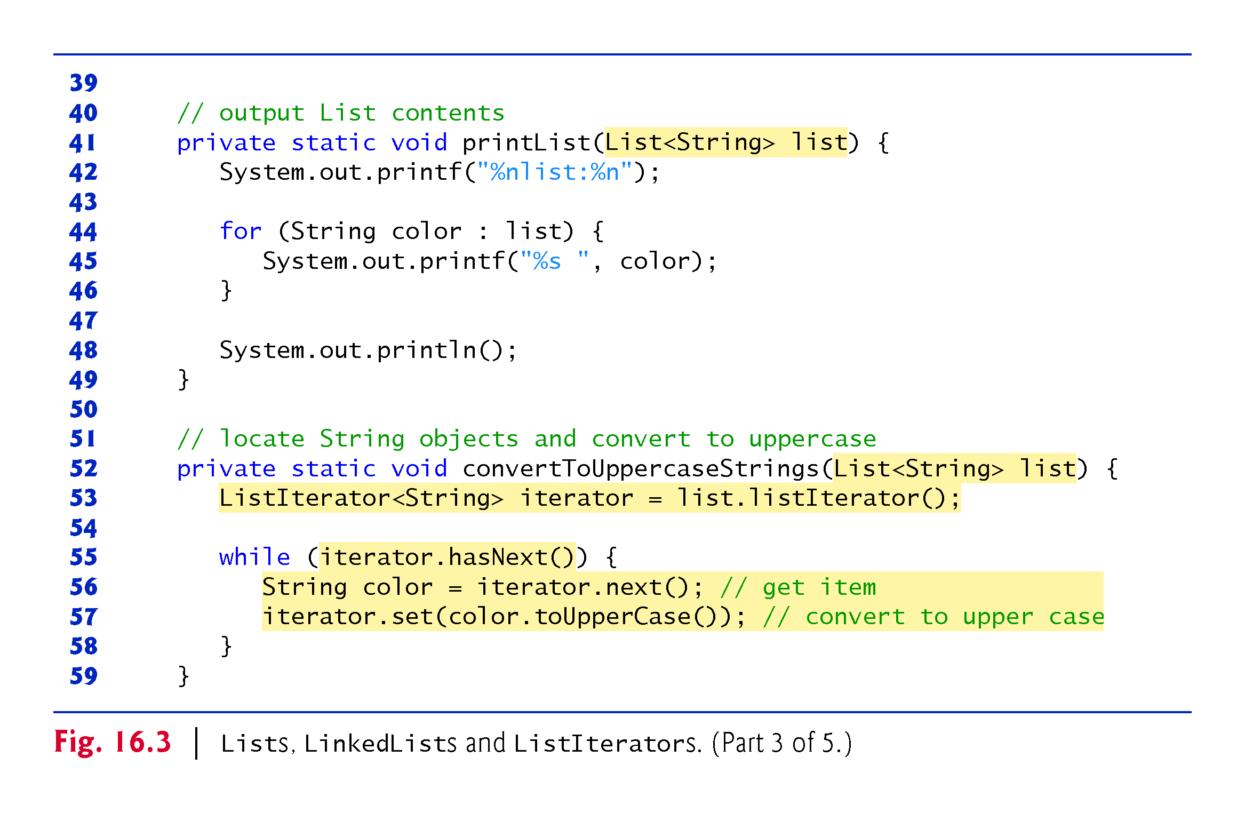

Slide 24
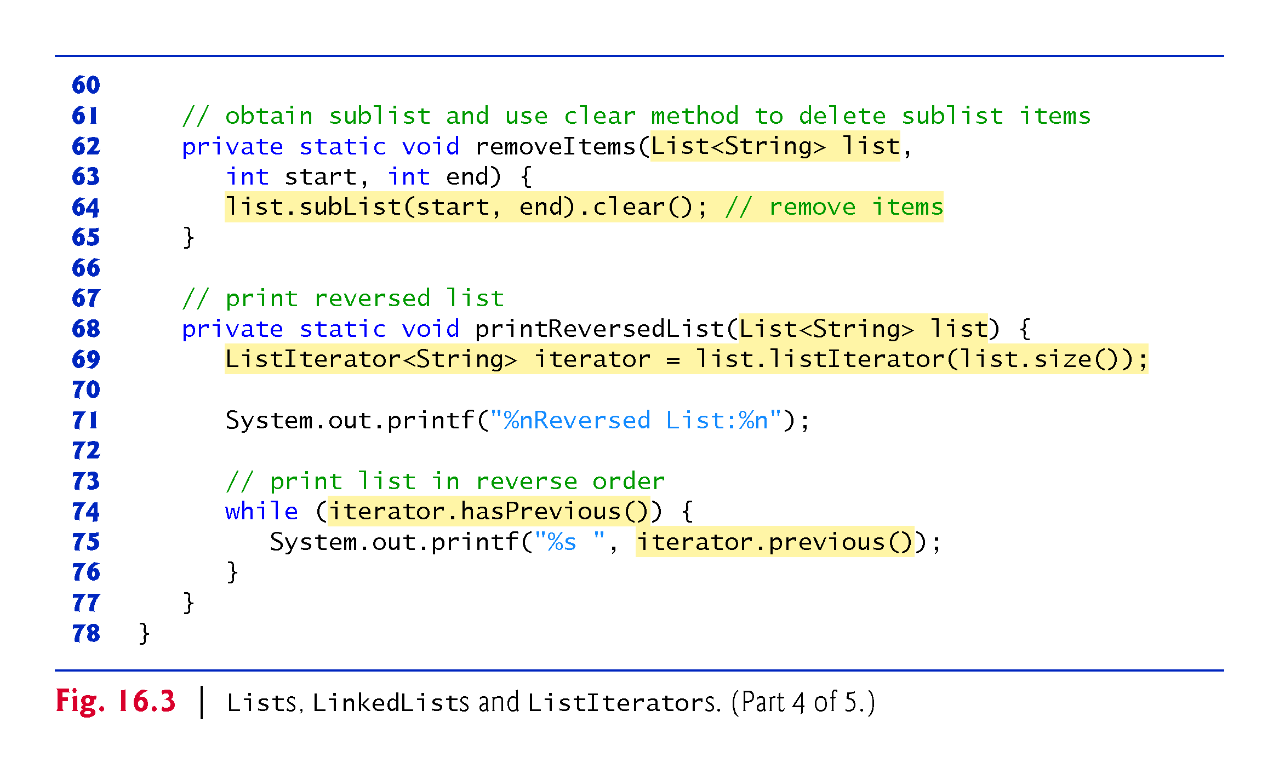

Slide 25
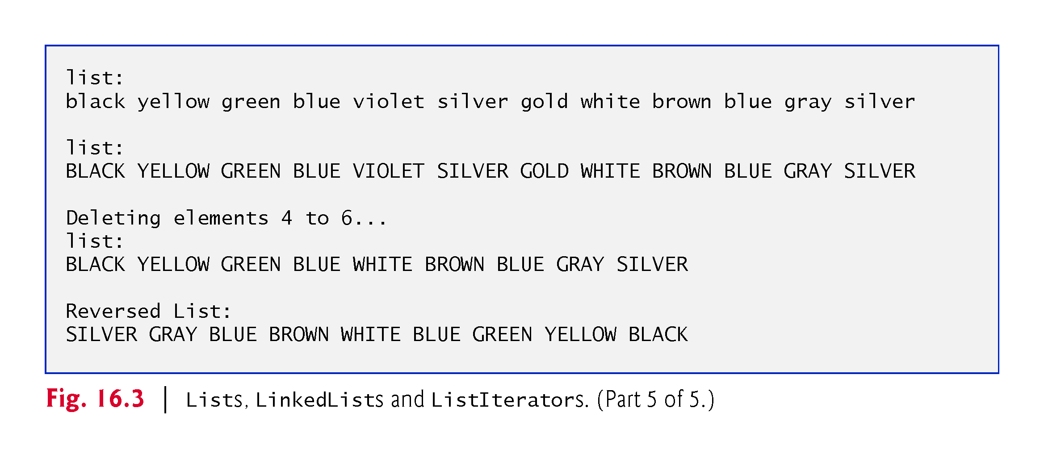

Slide 26
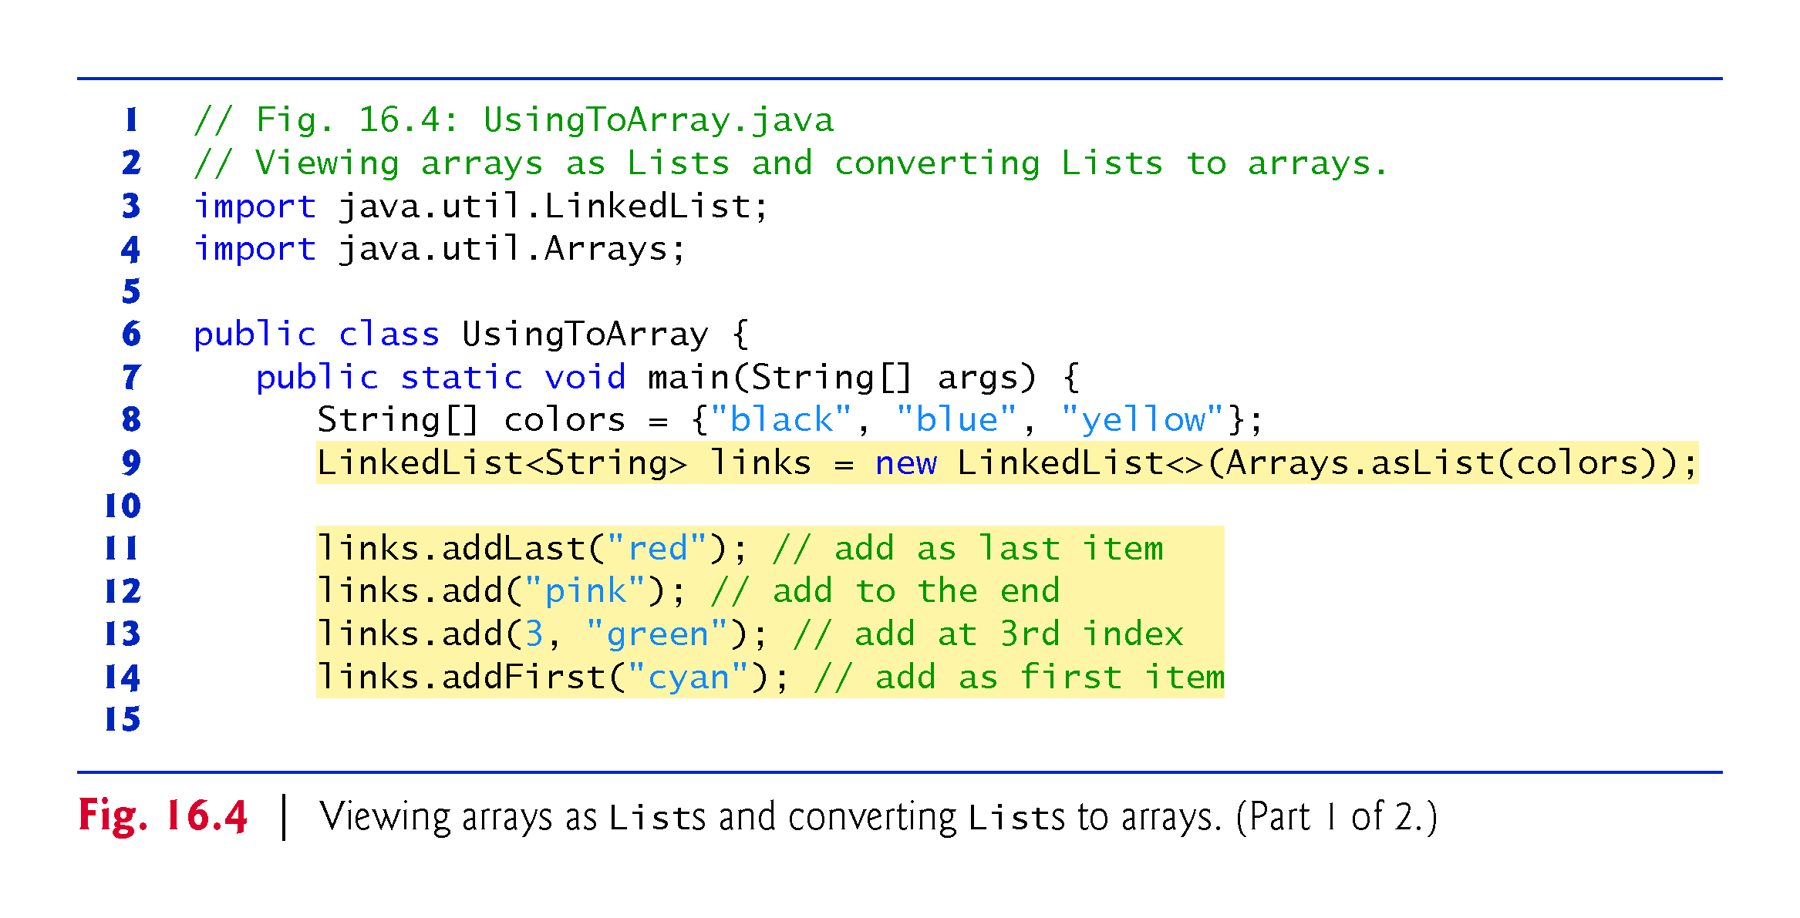

Slide 27
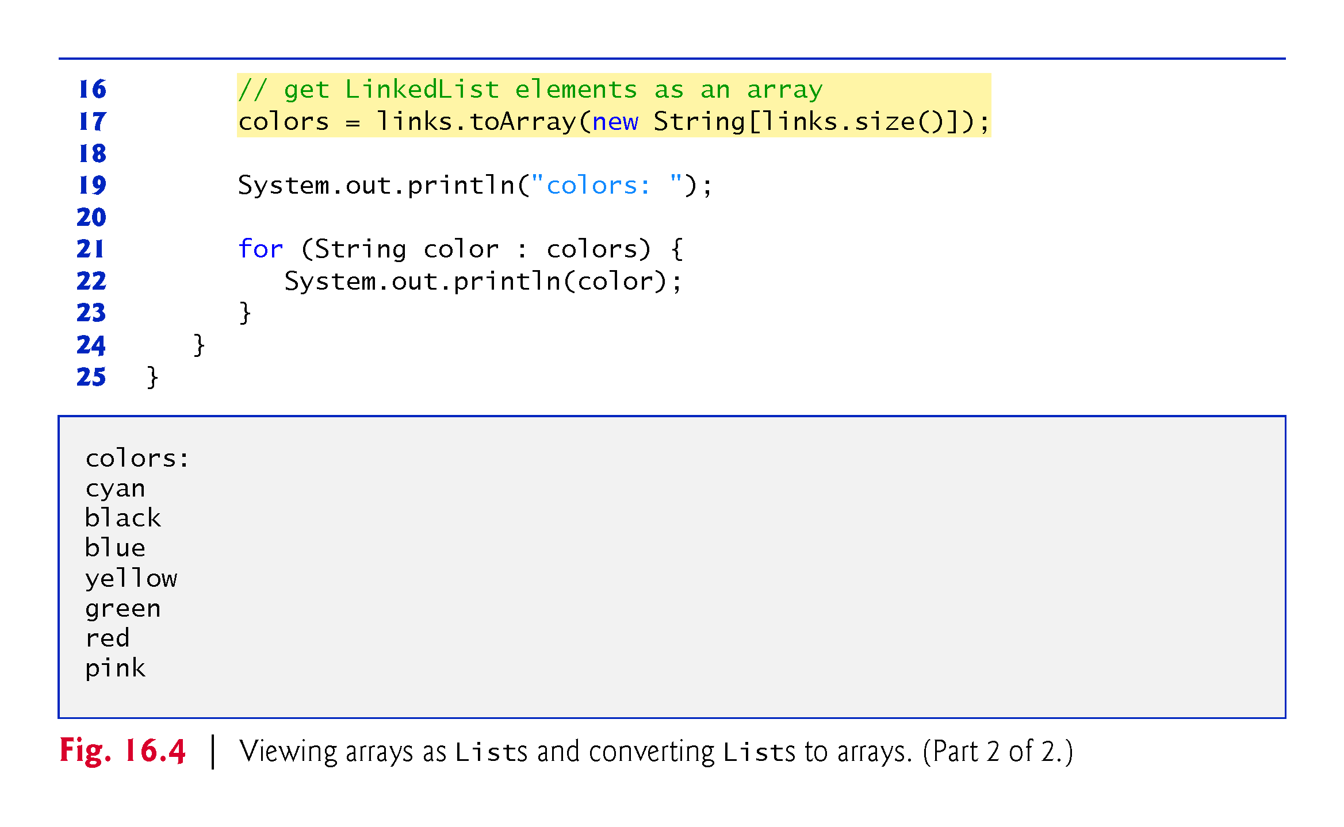

Slide 28
16.7 Collections Methods
Class Collections provides several high-performance algorithms for manipulating collection elements.
The algorithms (Fig. 16.5) are implemented as static methods.

Slide 29
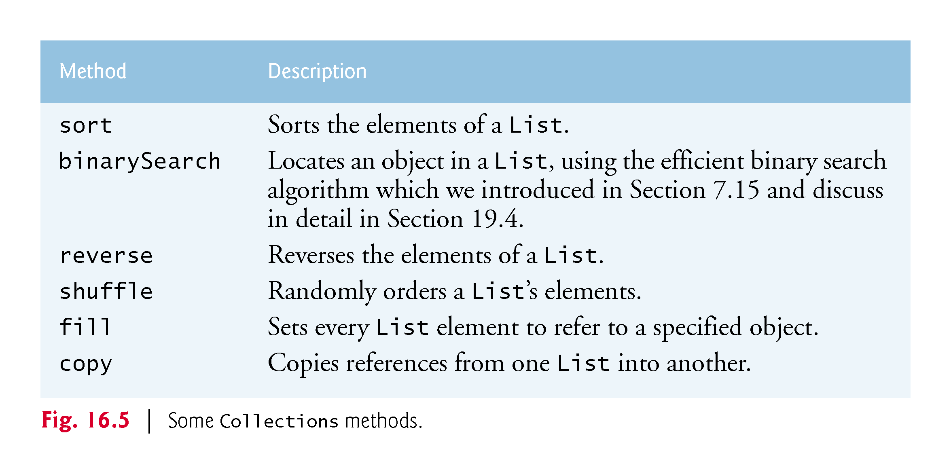

Slide 30
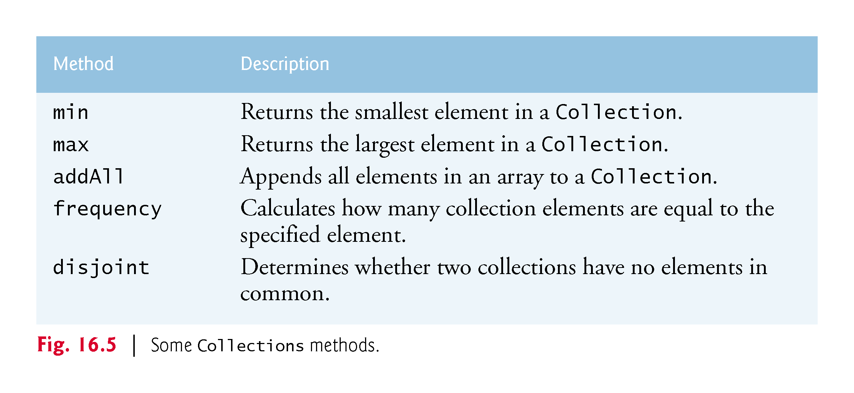

Slide 31
16.7.1 Method Sort
The method sort sorts the Elements of a List.
The elmements’ type must implement the interface Comparable.
The order is determined by the natural order of the elements’ type as implemented by the compareTo method of the Comparable interface.
Figure 16.6 users Collections method sort to order the elements of a list in ascending order.

Slide 32
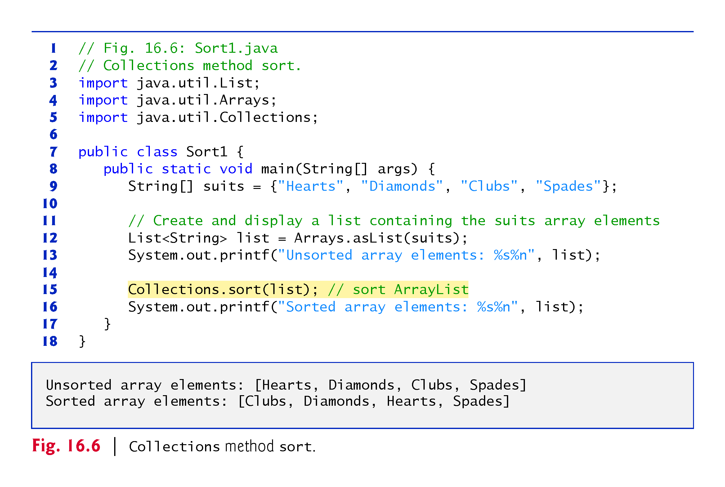

Slide 33
16.7.1 Method Sort (Cont.)
Figure 16.7 sorts the same list of string in descending order.
The Comparator interface is used for sorting a Collection’s elements in a different order.
The static Collections method reverseOrder returns a Comparator object that orders the collection’s elements in reverse order.

Slide 34
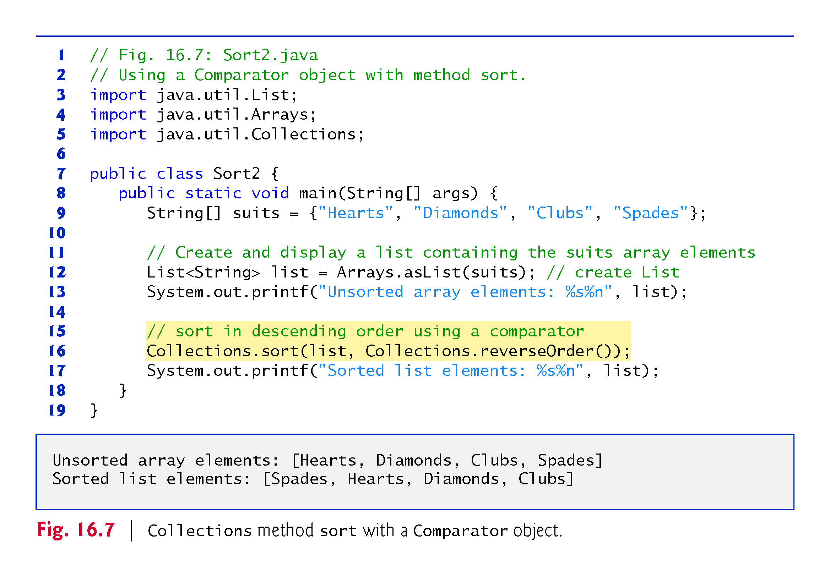

Slide 35
16.7.1 Method Sort (Cont.)
Figure 16.8 creates a custom Comparator class, named TimeComparator, that implements interface Comparator to compare two Time2 objects.
Class Time2, declared in Fig. 8.5, represents times with hours, minutes and seconds.
Class TimeComparator implements interface Comparator, a generic type that takes one type argument.
A class that implements Comparator must declare a compare method that receives two arguments and returns a negative integer if the first argument is less than the second, 0 if the arguments are equal or a positive integer if the first argument is greater than the second.

Slide 36
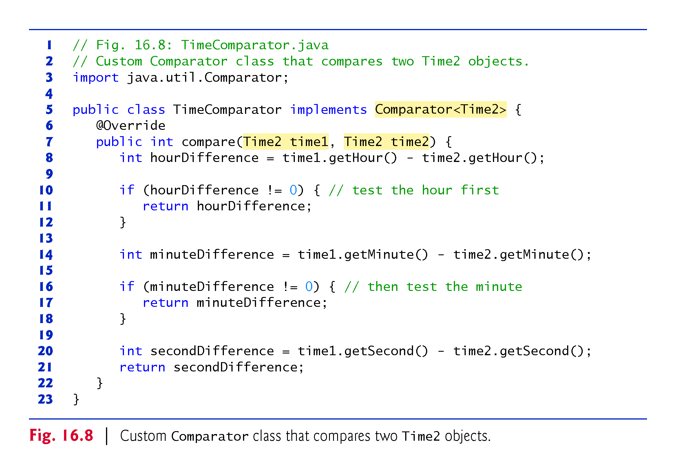

Slide 37
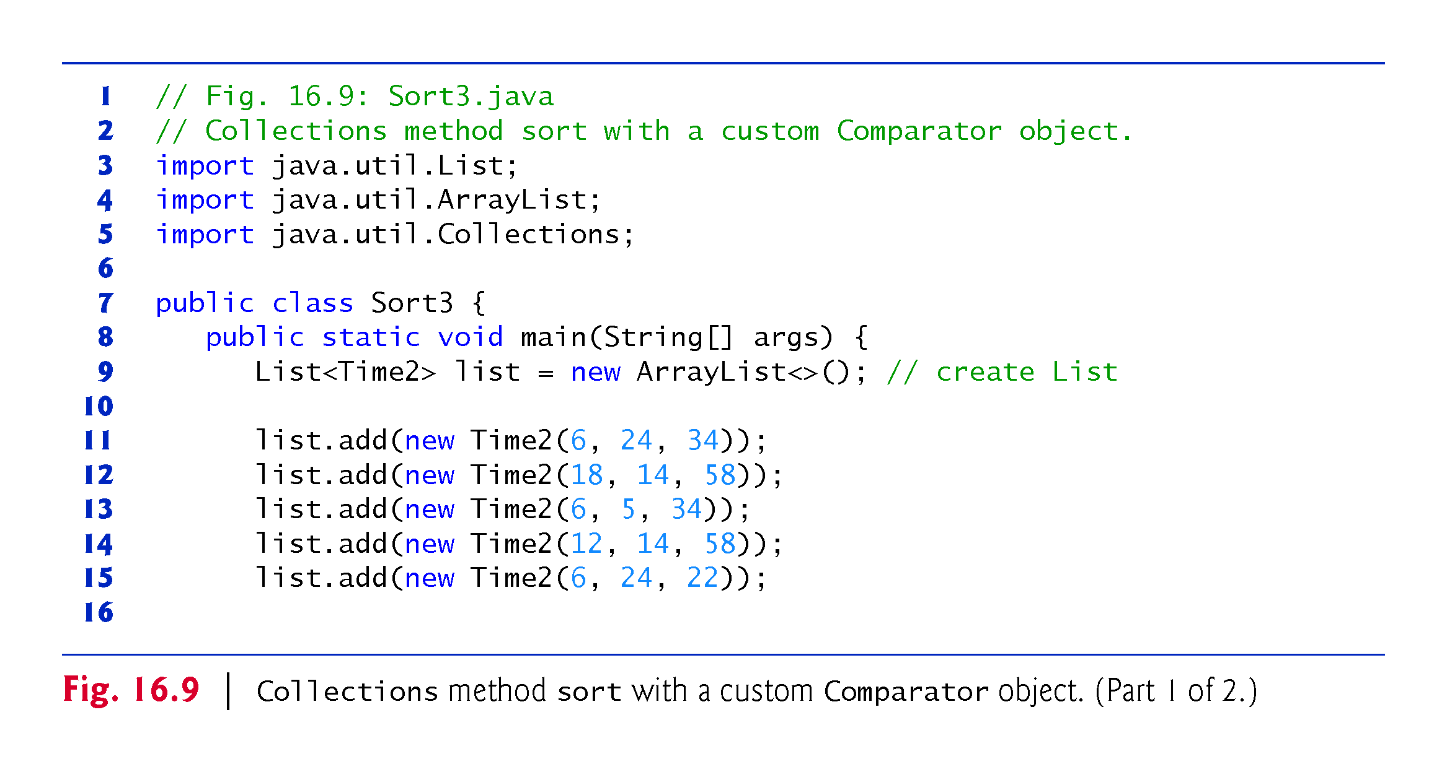

Slide 38
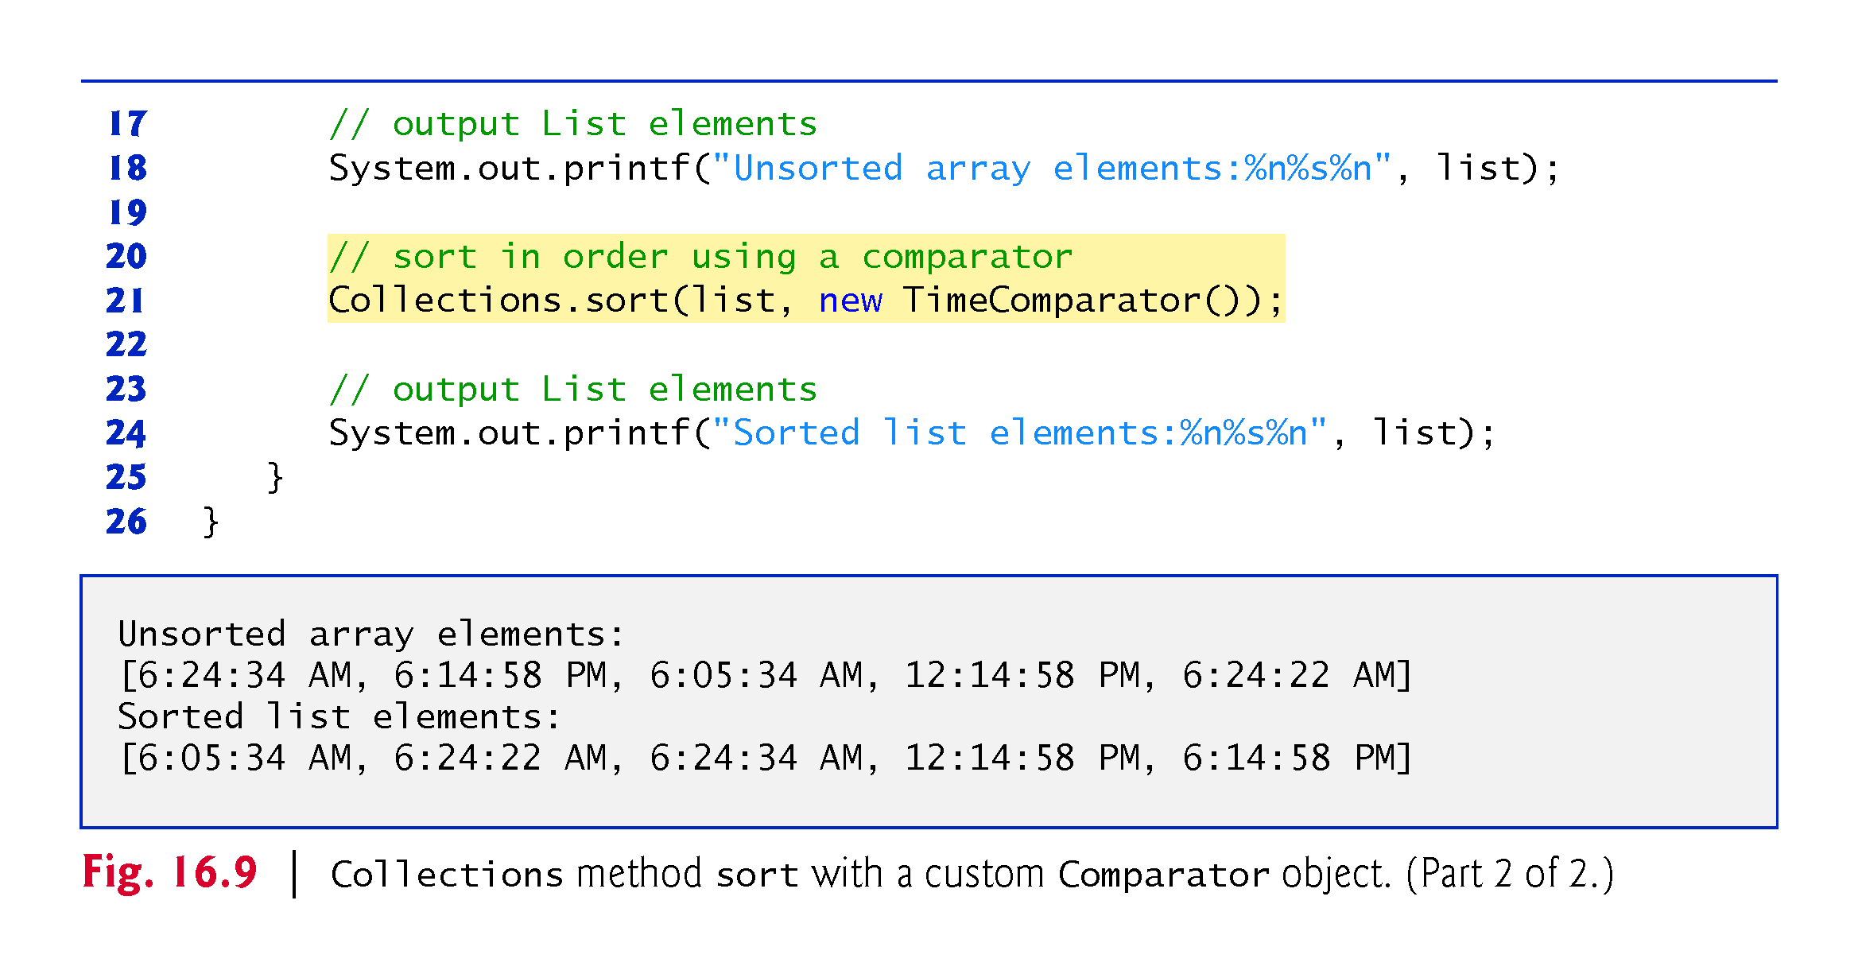

Slide 39
16.7.2 Method shuffle
Method shuffle randomly orders a List’s elements.

Slide 40
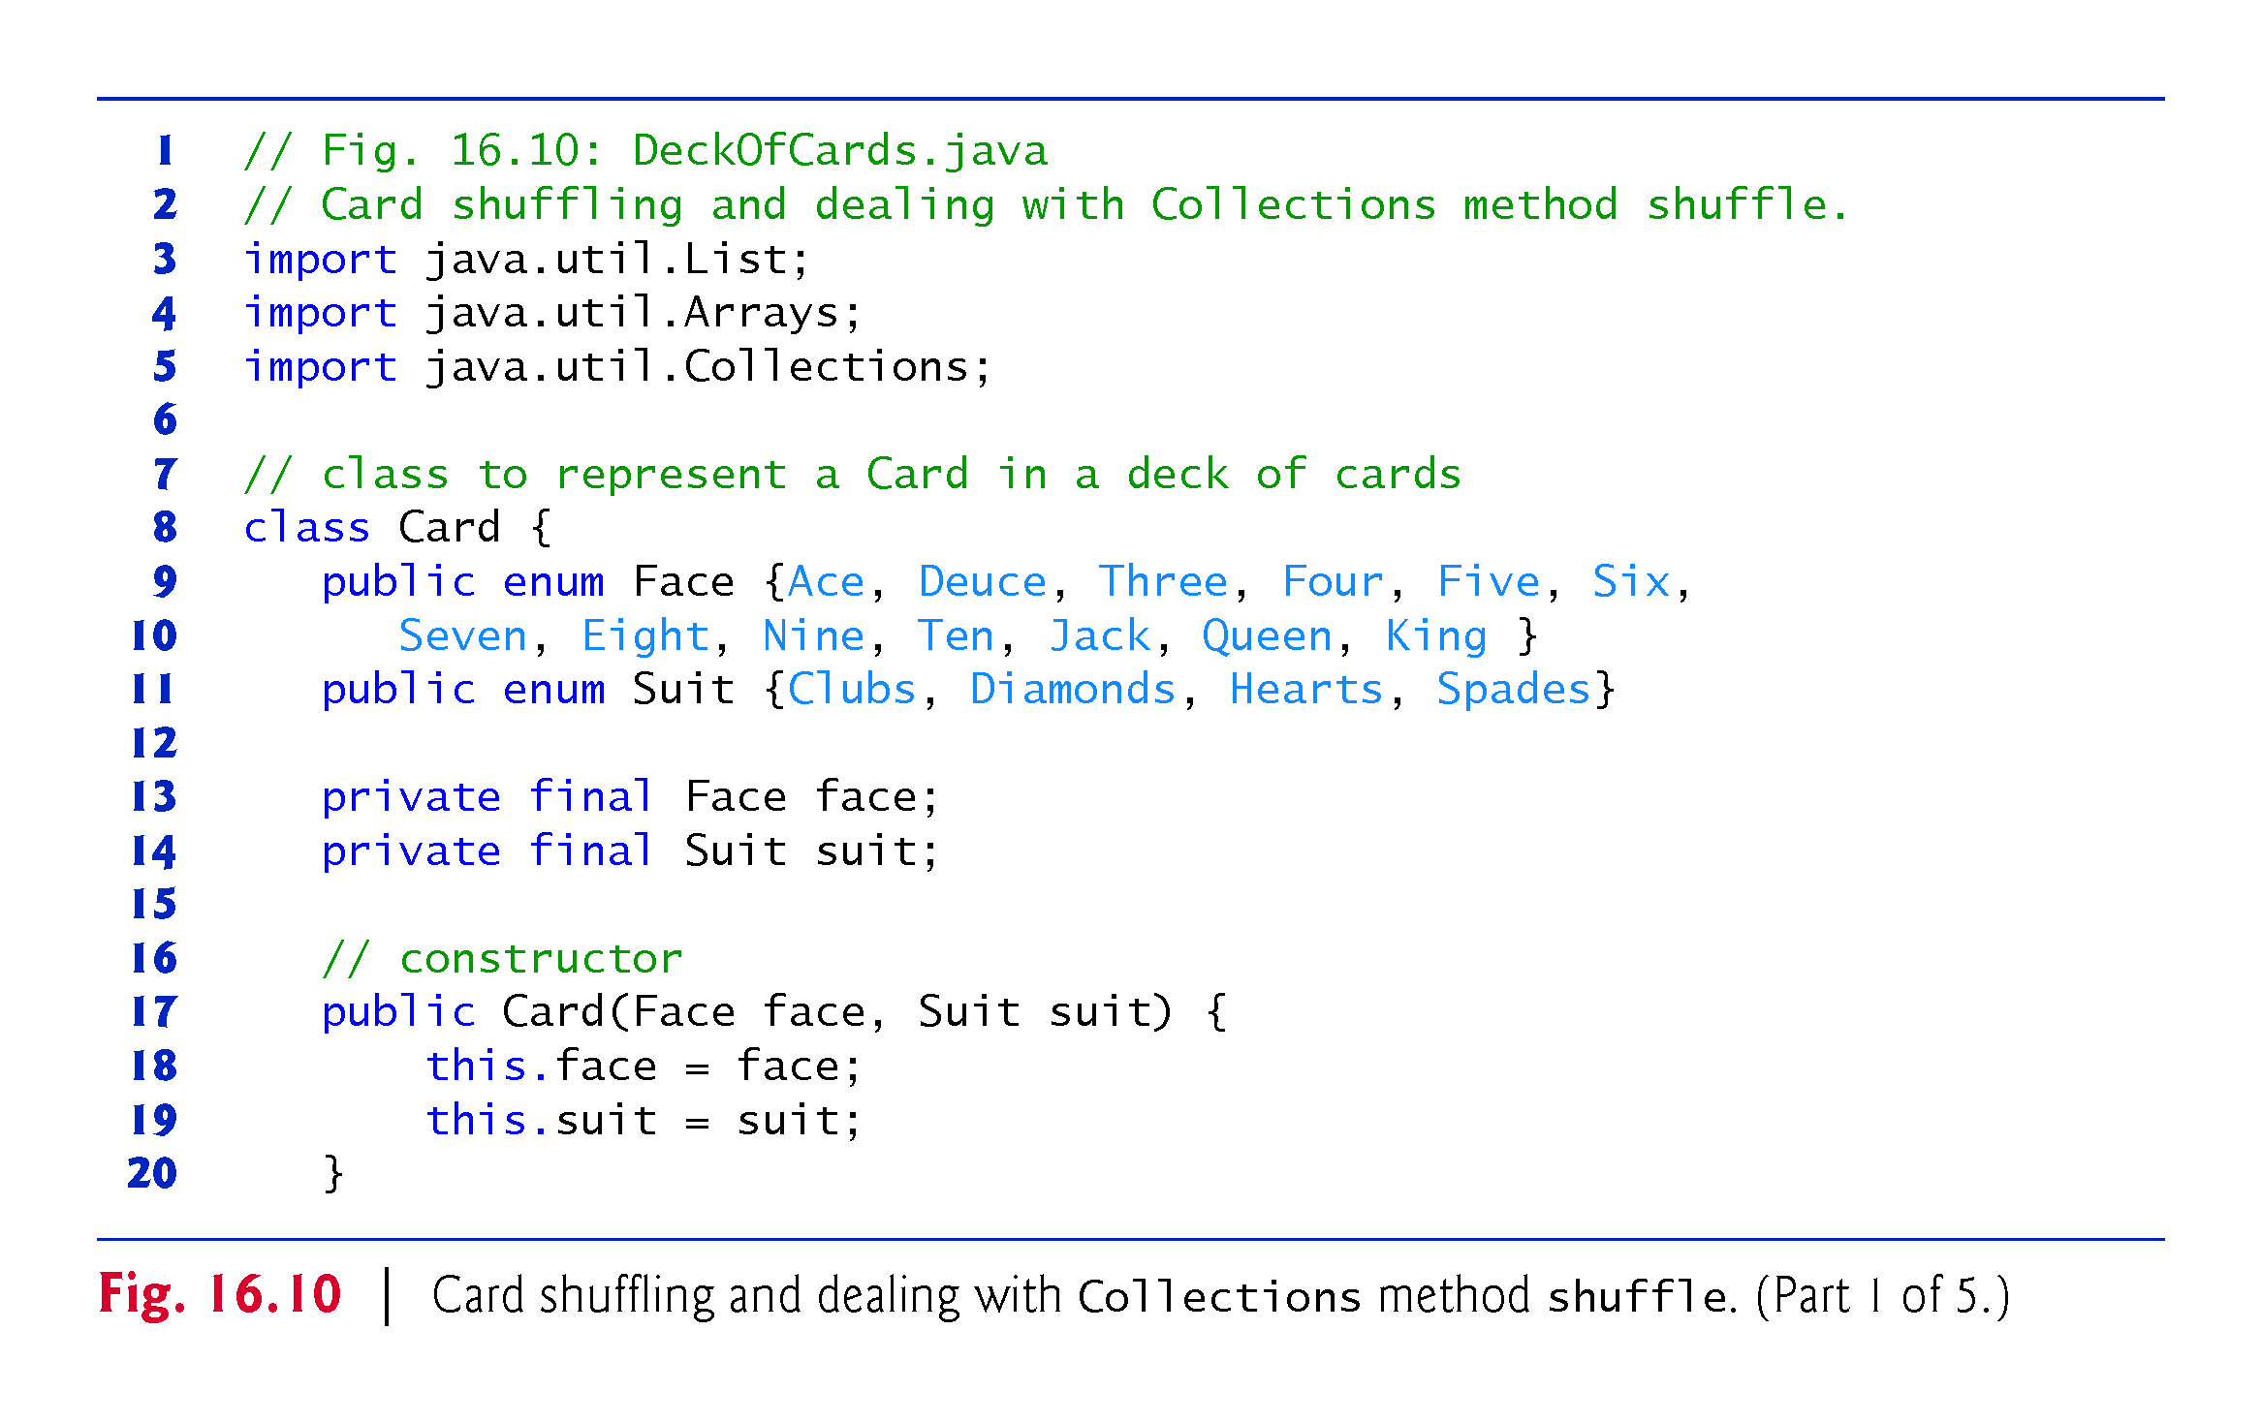

Slide 41
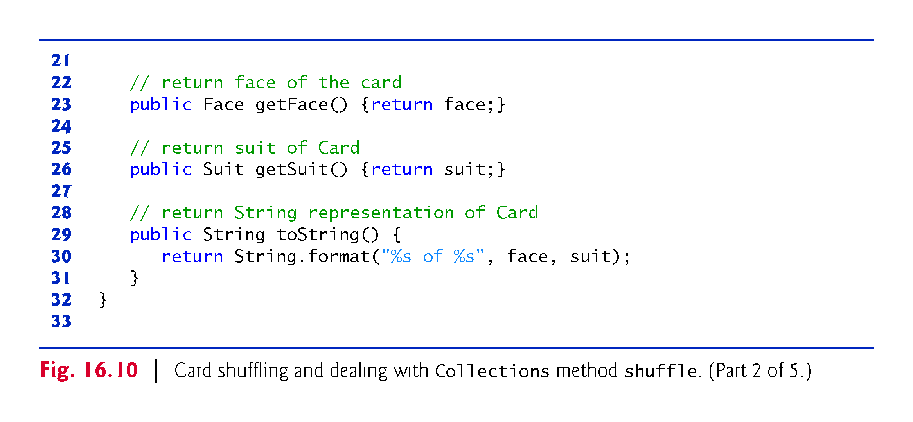

Slide 42
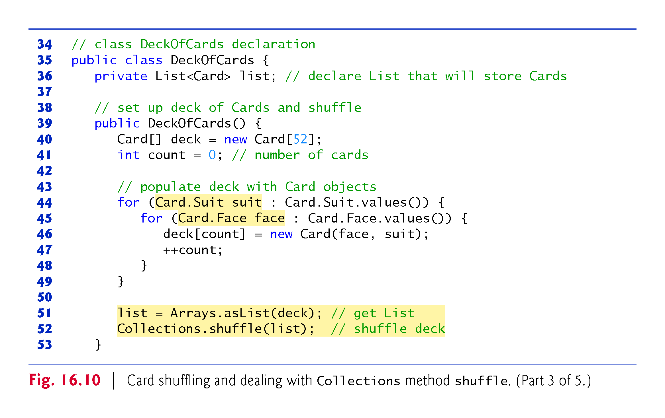

Slide 43
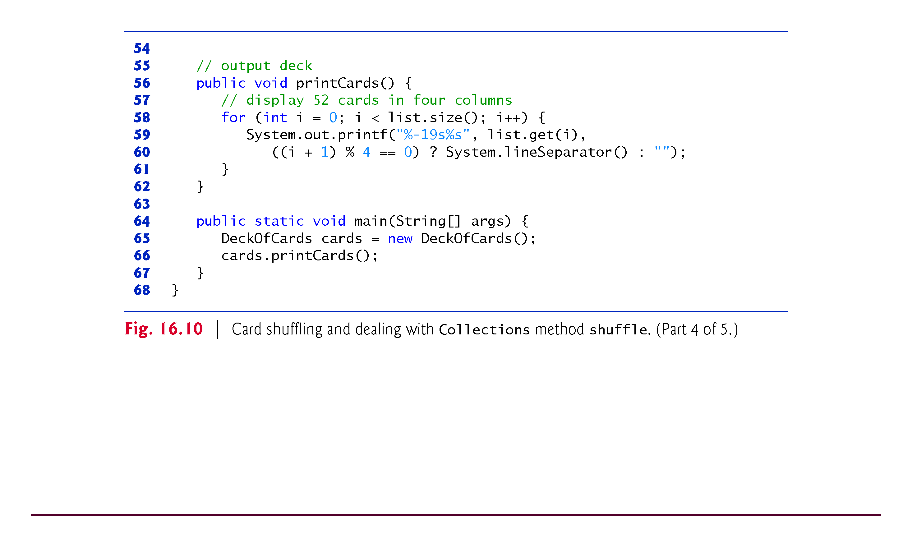

Slide 44
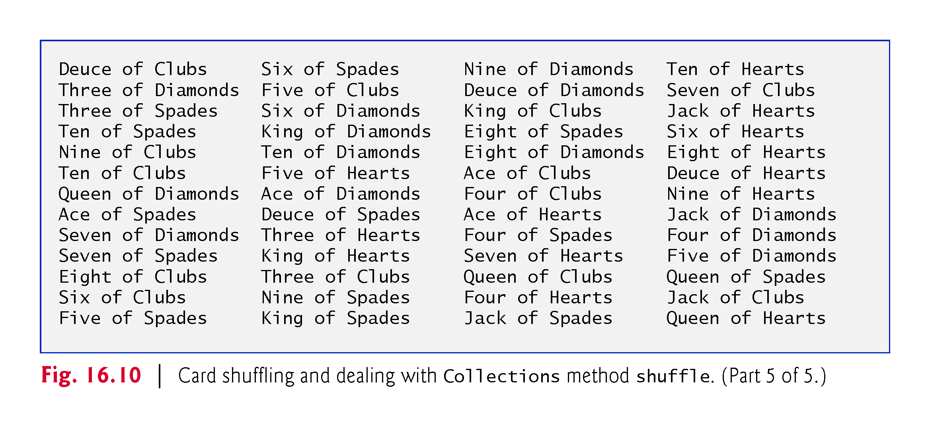

Slide 45
16.7.3 Methods reverse, fill, copy, max and min
Collections method reverse reverses the order of the elements in a List
Method fill overwrites elements in a List with a specified value.
Method copy takes two arguments—a destination List and a source List.
Each source List element is copied to the destination List.
The destination List must be at least as long as the source List; otherwise, an IndexOutOfBoundsException occurs.
If the destination List is longer, the elements not overwritten are unchanged.
Methods min and max each operate on any Collection.
Method min returns the smallest element in a Collection, and method max returns the largest element in a Collection.

Slide 46
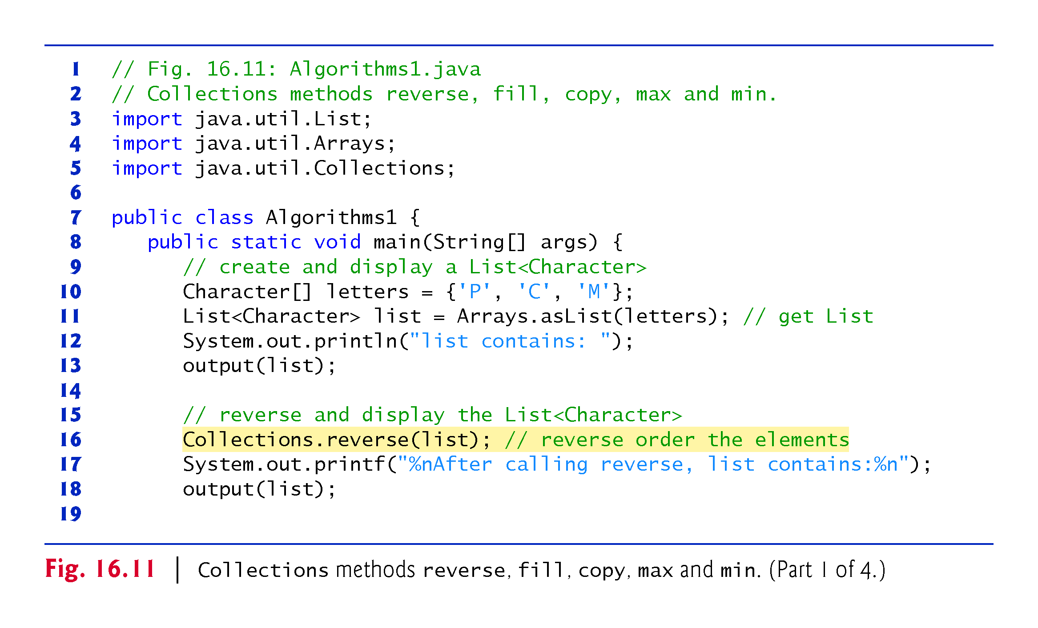

Slide 47
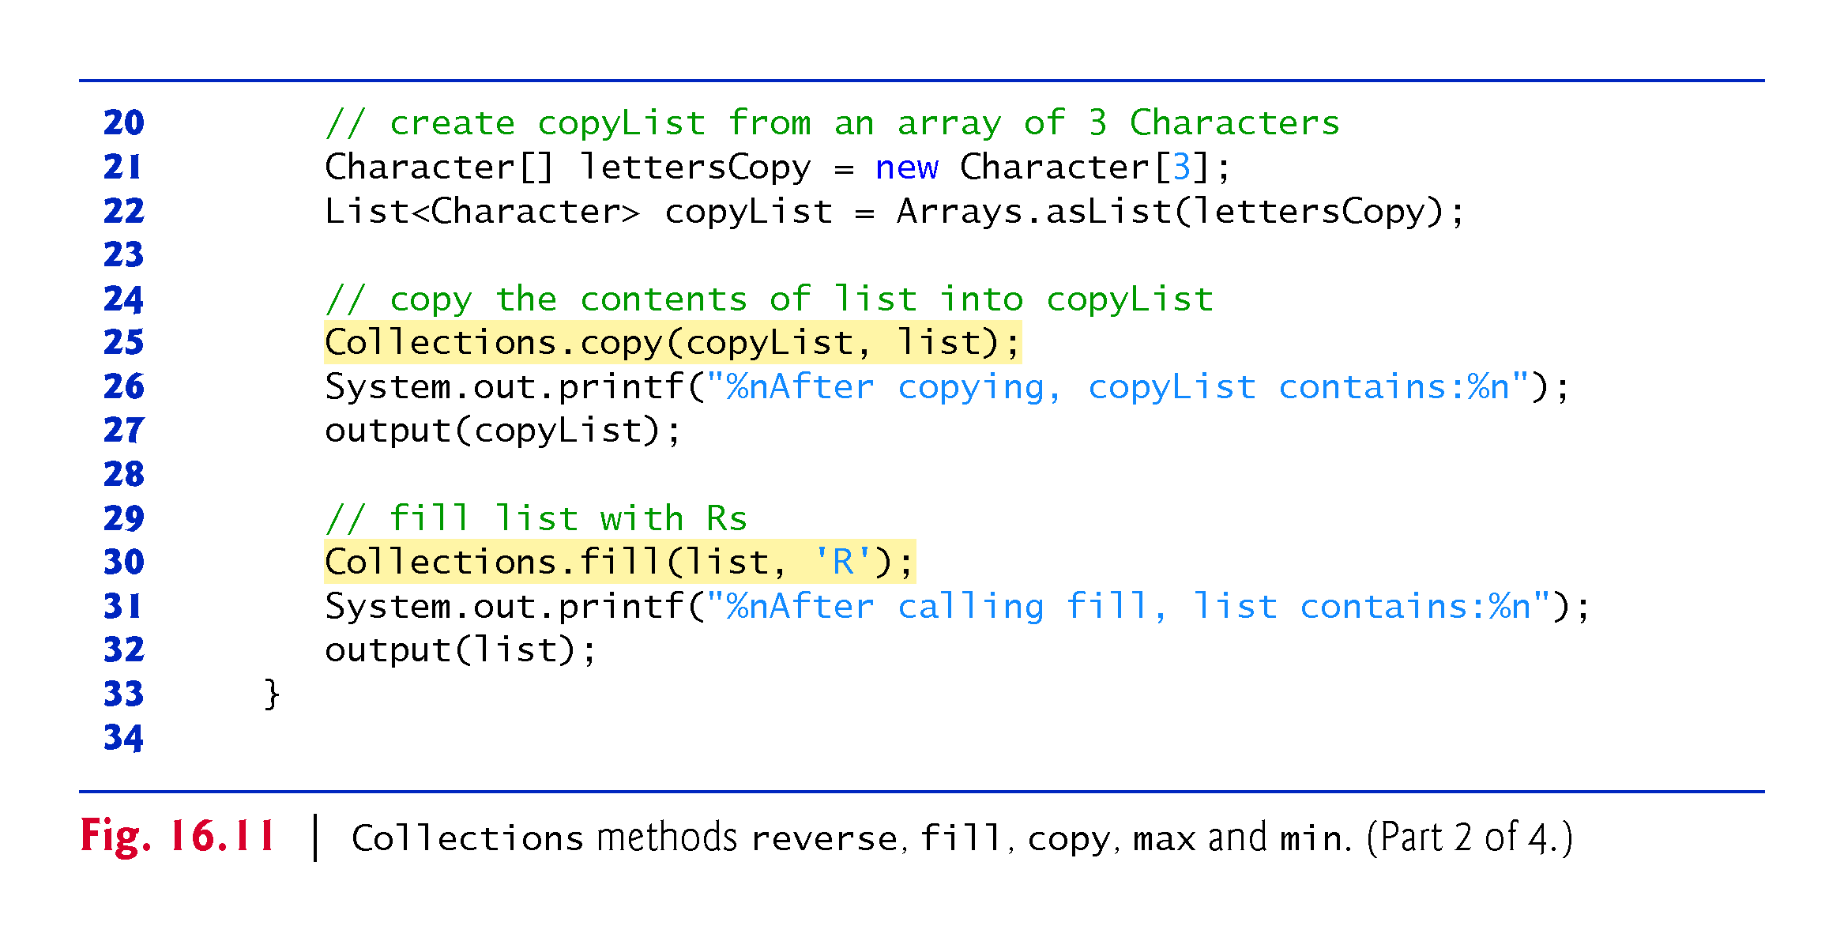

Slide 48
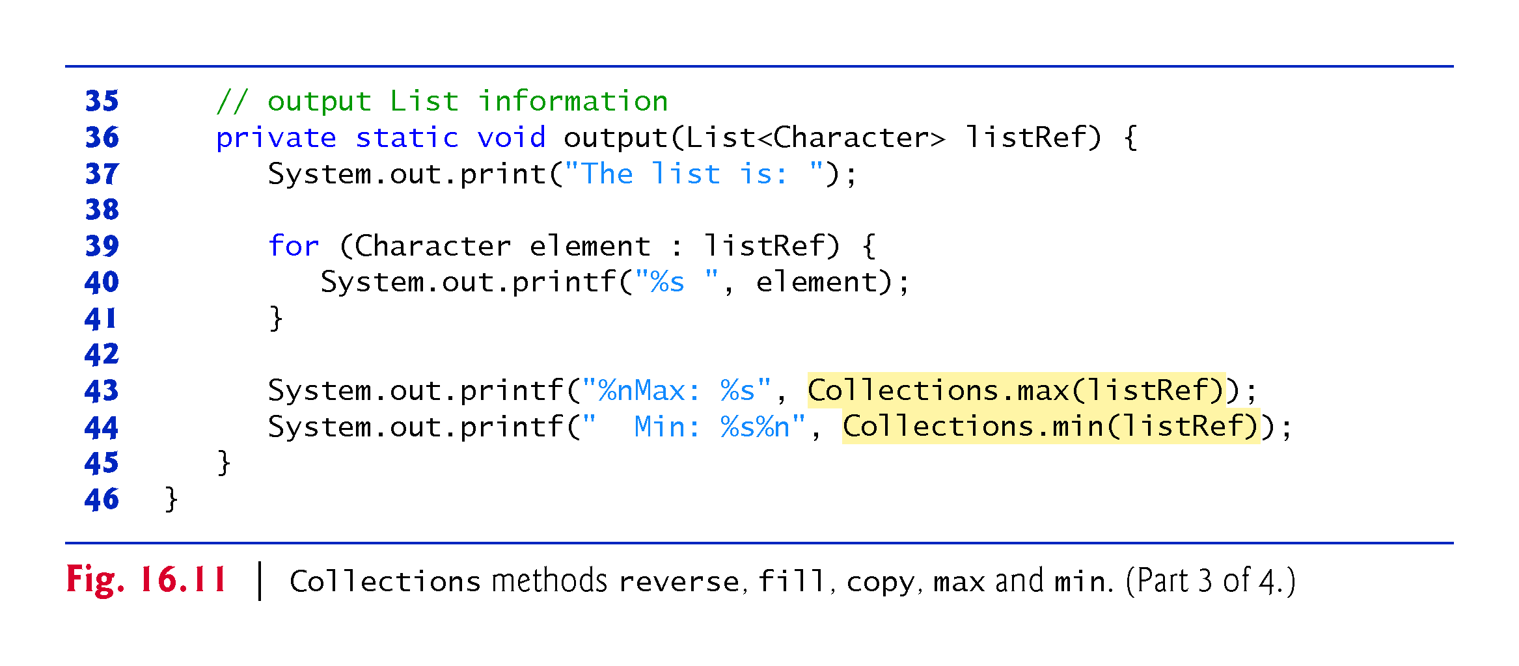

Slide 49
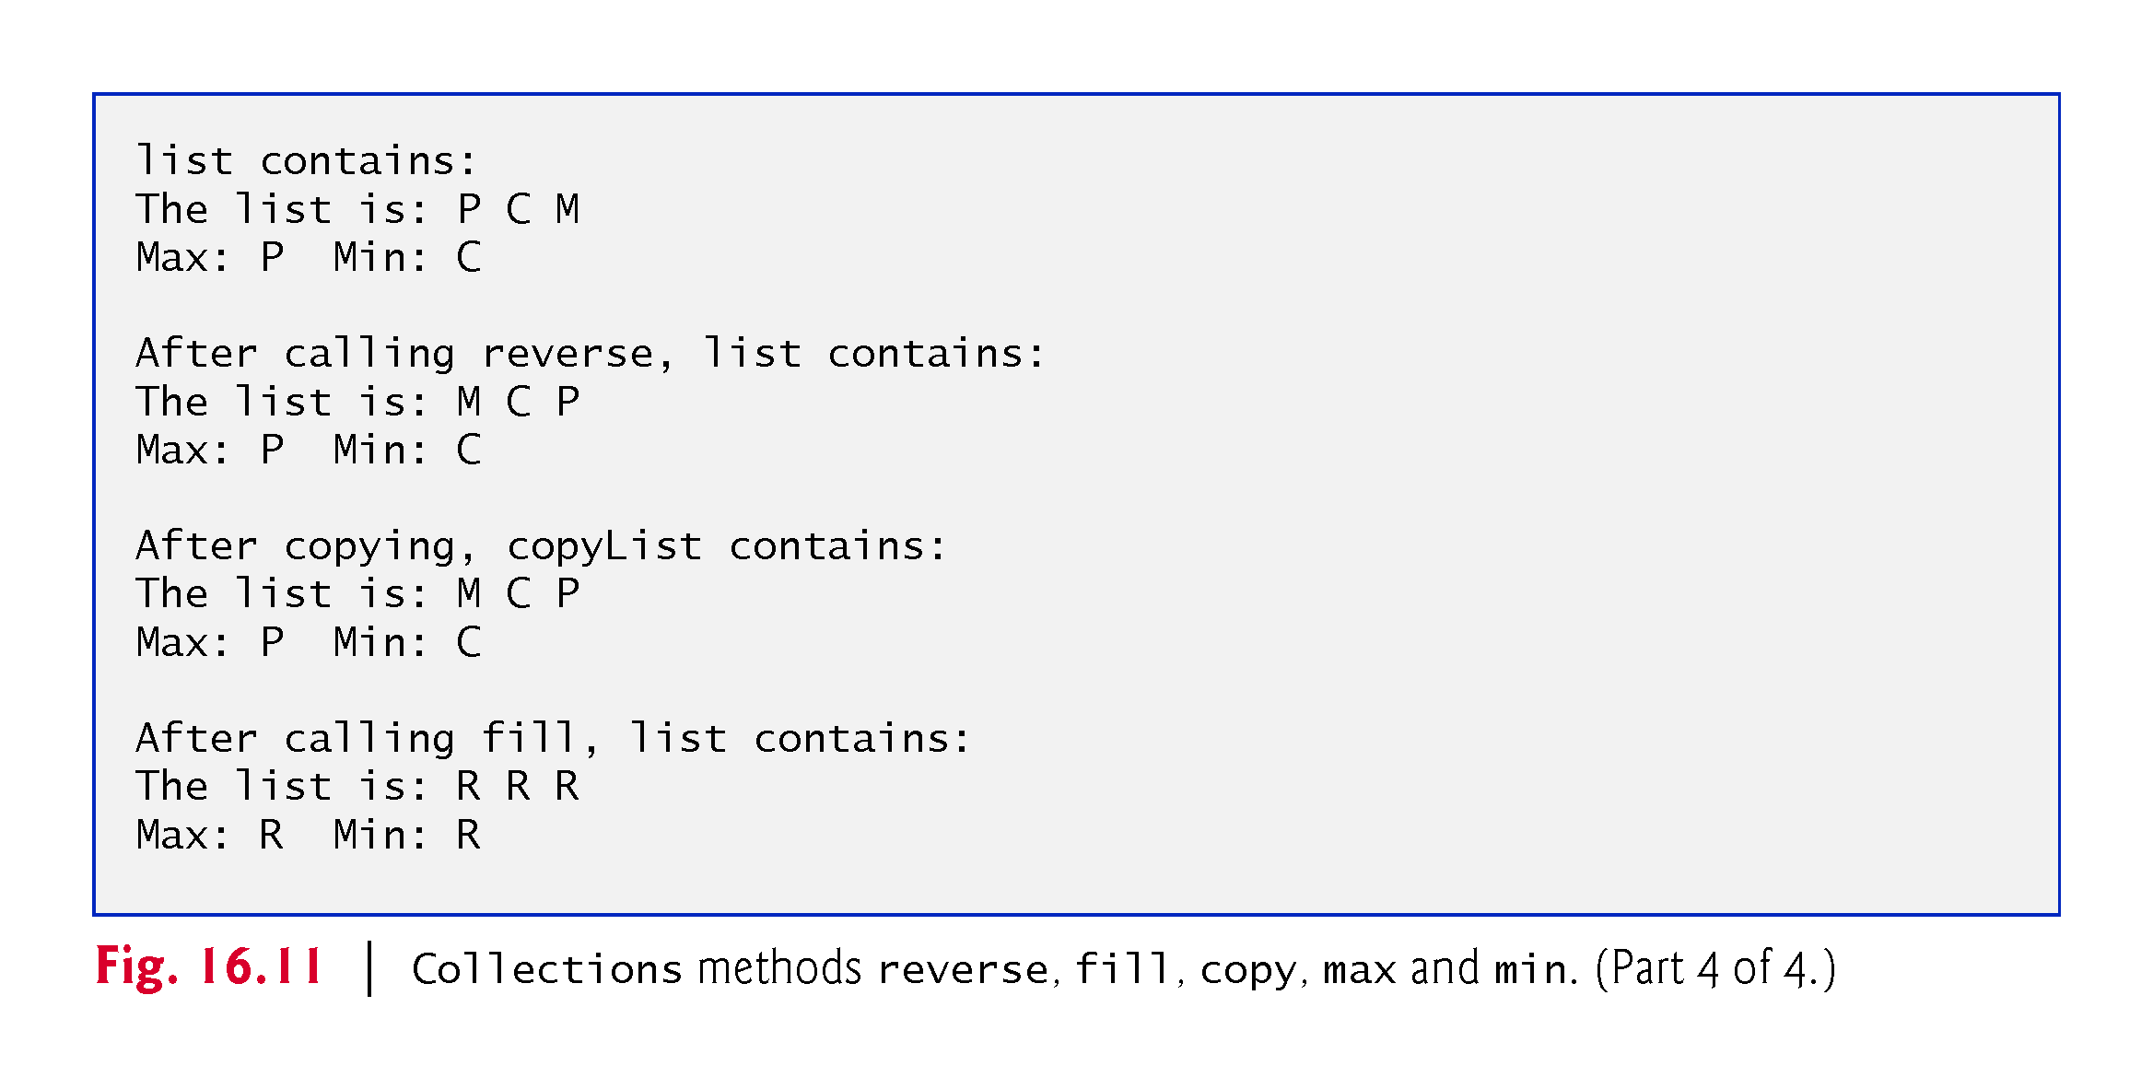

Slide 50
16.7.4 Method binarySearch
static Collections method binarySearch locates an object in a List.
If the object is found, its index is returned.
If the object is not found, binarySearch returns a negative value.

Slide 51
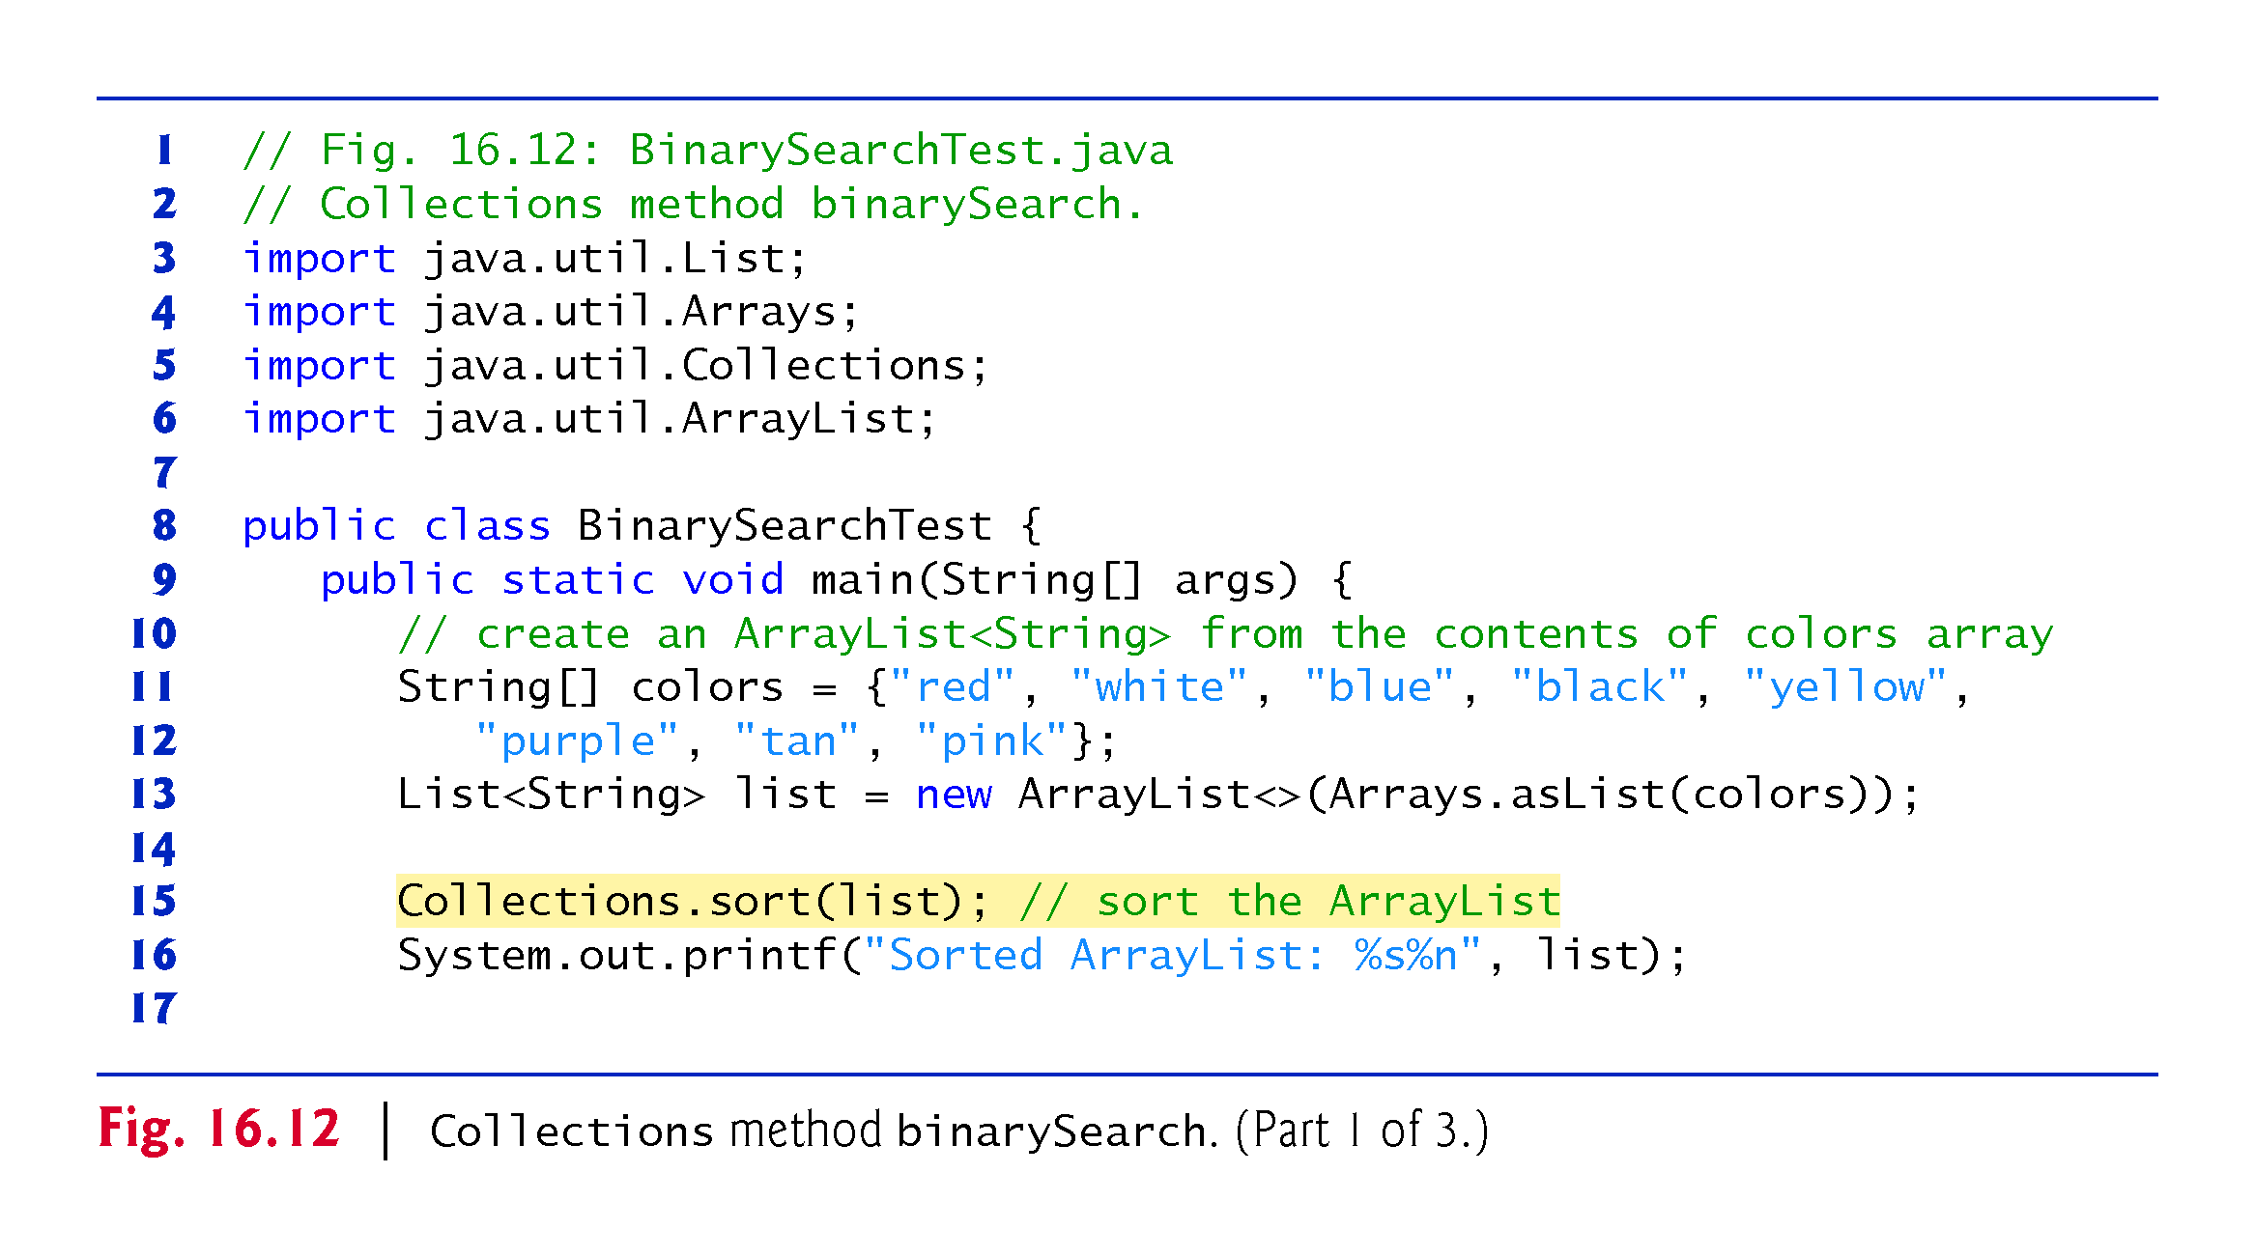

Slide 52
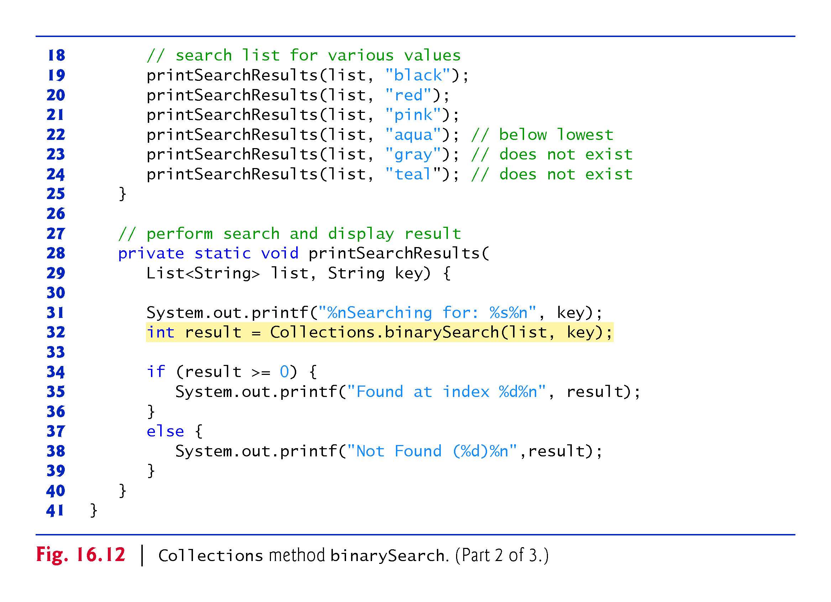

Slide 53
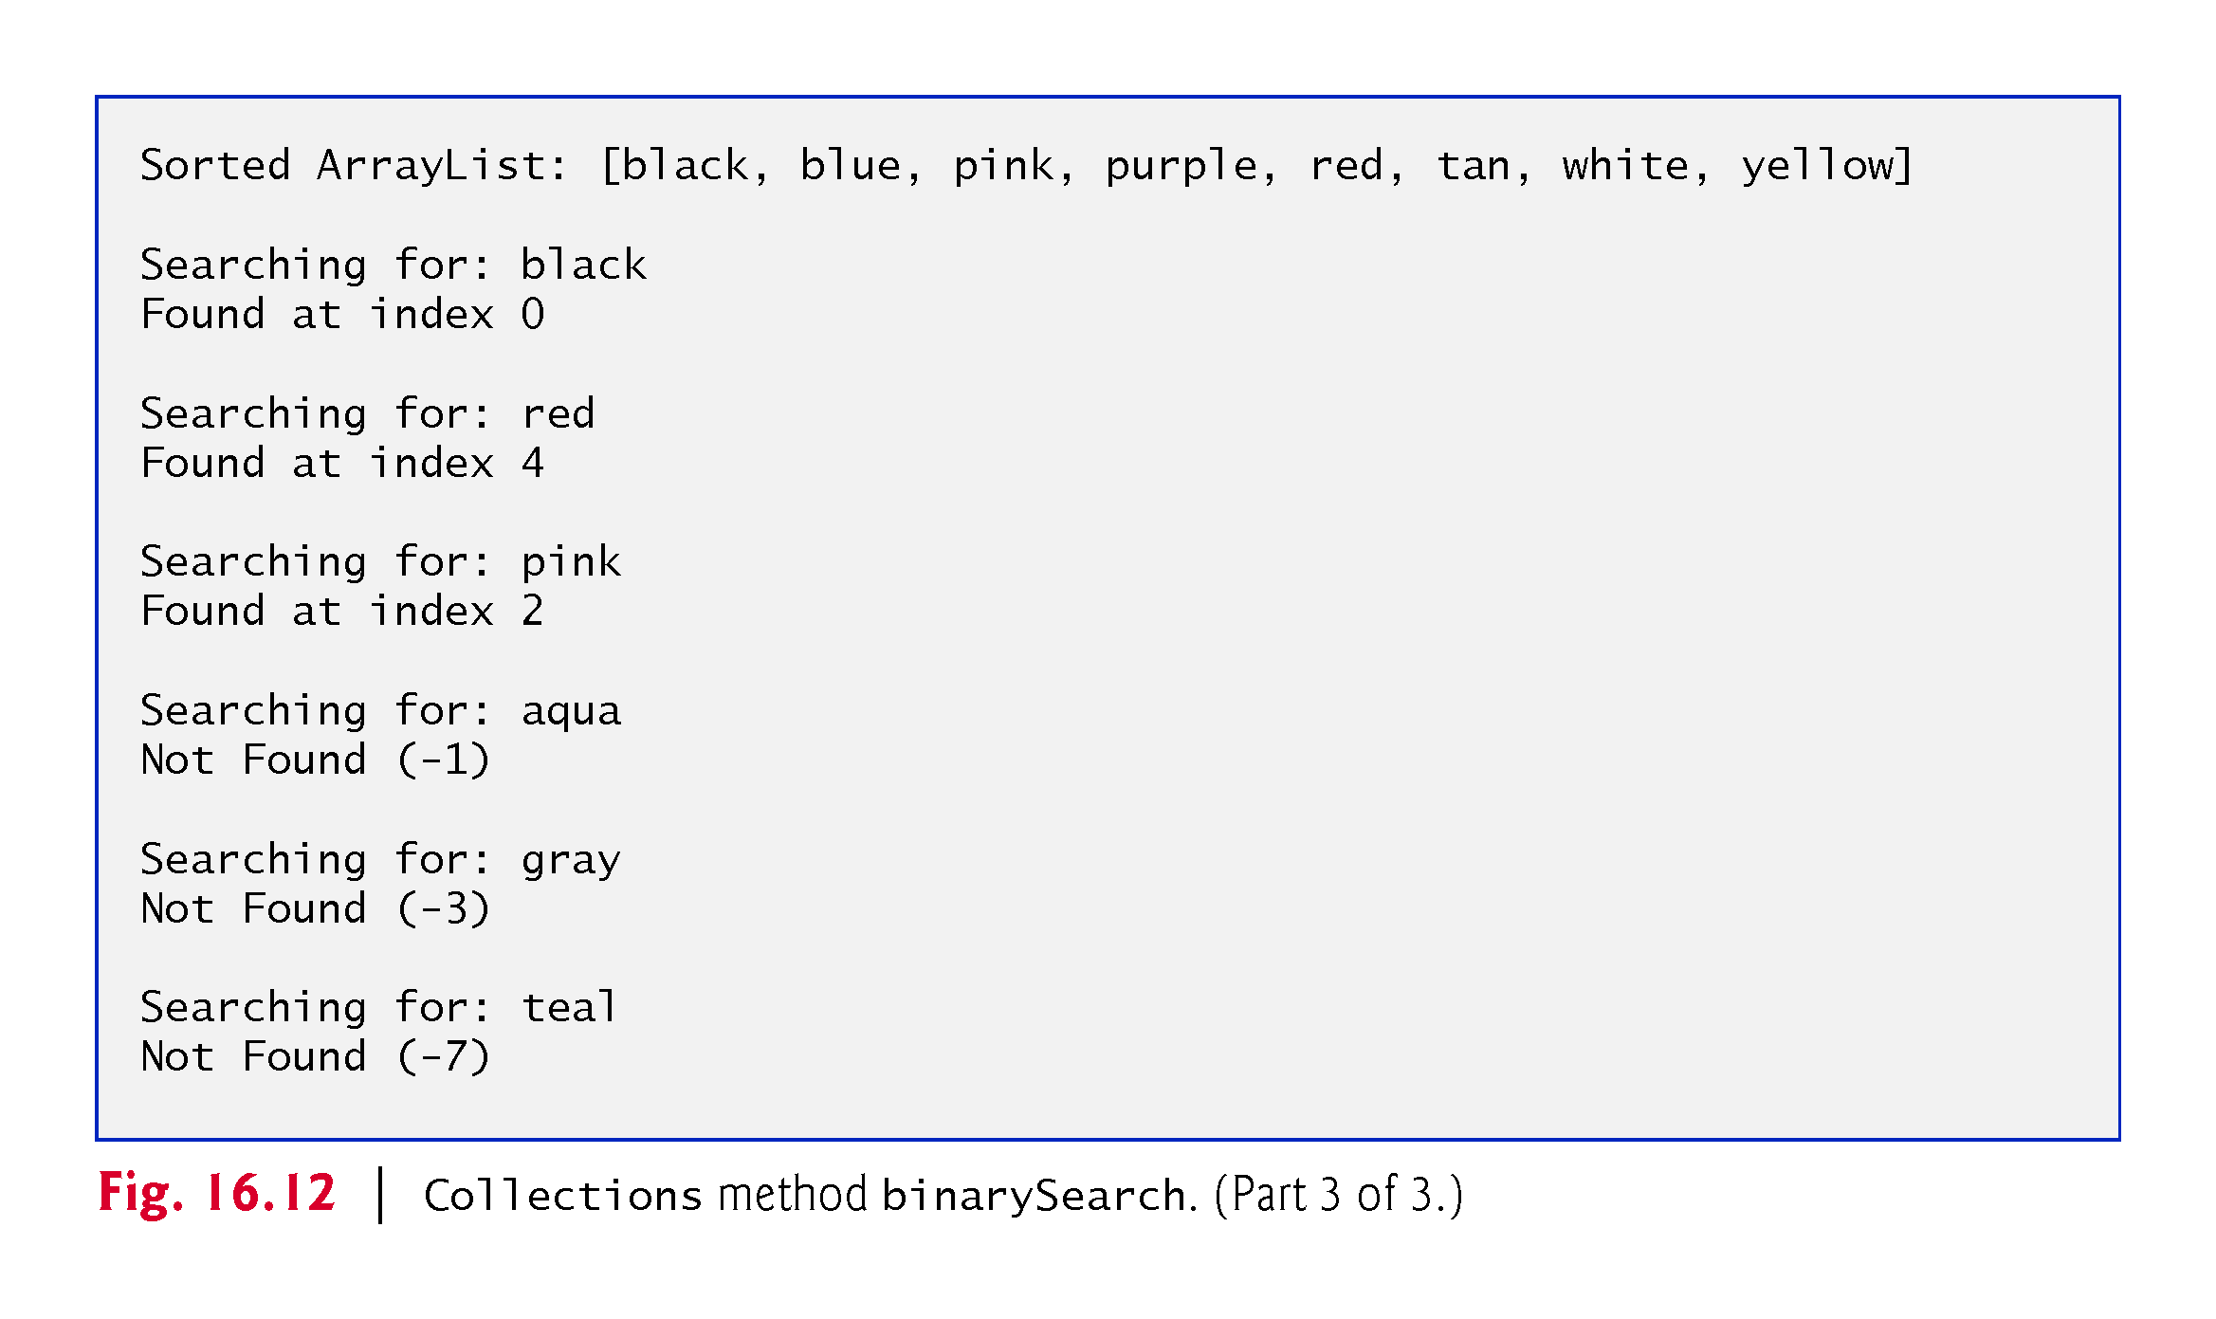

Slide 54
16.7.5 Methods addAll, frequency and disjoint
Collections method addAll takes two arguments—a Collection into which to insert the new element(s) and an array that provides elements to be inserted.
Collections method frequency takes two arguments—a Collection to be searched and an Object to be searched for in the collection.
Method frequency returns the number of times that the second argument appears in the collection.
Collections method disjoint takes two Collections and returns true if they have no elements in common.

Slide 55
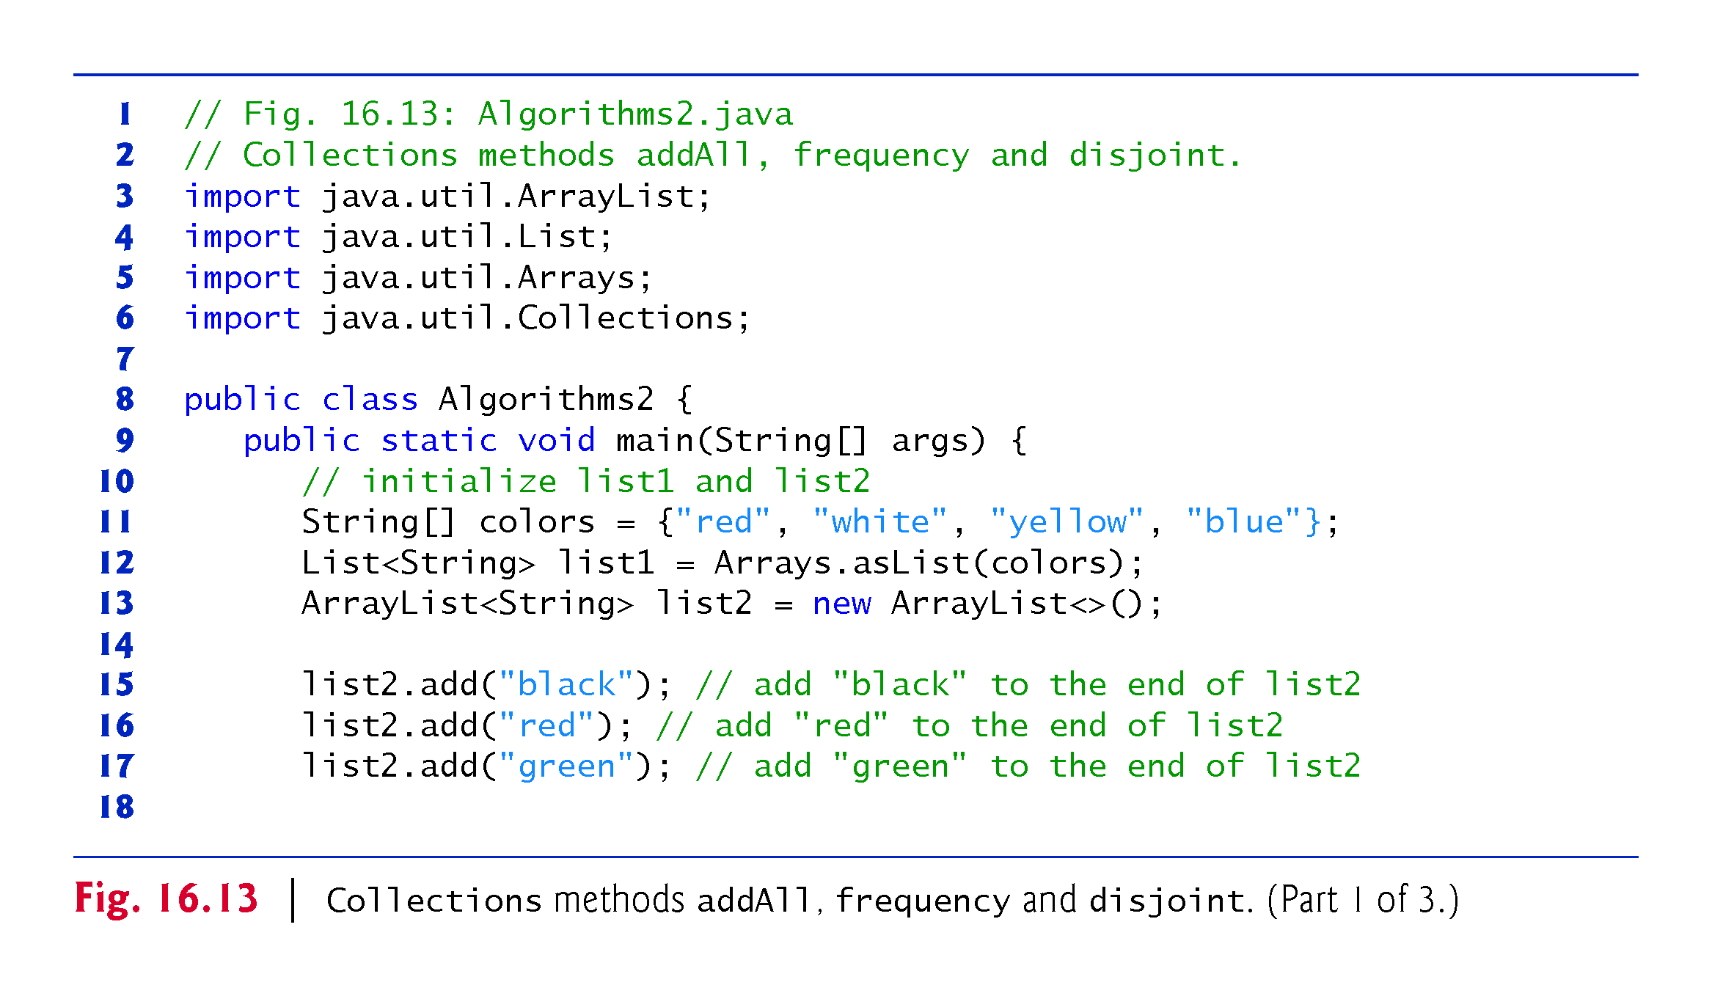

Slide 56
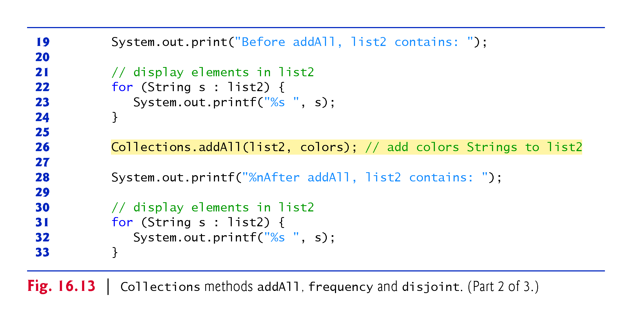

Slide 57
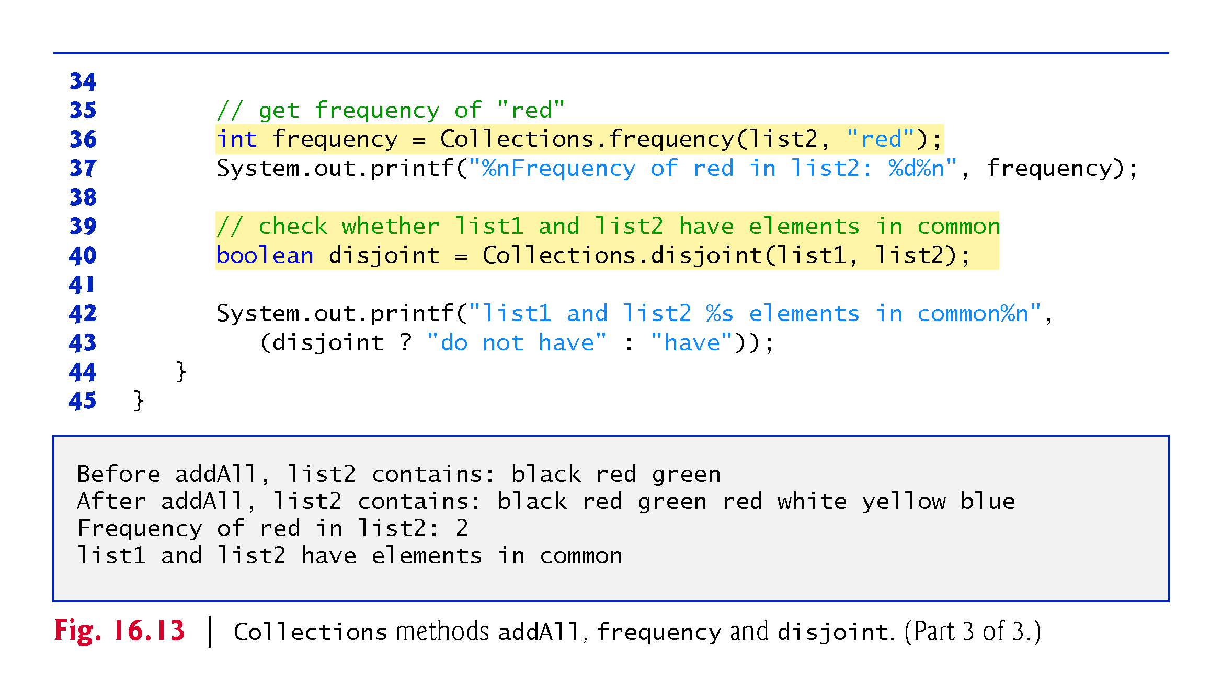

Slide 58
16.8 Class PriorityQueue and Interface Queue
Interface Queue extends interface Collection and provides additional operations for inserting, removing and inspecting elements in a queue.
PriorityQueue orders elements by their natural ordering.
Elements are inserted in priority order such that the highest-priority element (i.e., the largest value) will be the first element removed from the PriorityQueue.
Common PriorityQueue operations are
offer to insert an element at the appropriate location based on priority order
poll to remove the highest-priority element of the priority queue
peek to get a reference to the highest-priority element of the priority queue
clear to remove all elements in the priority queue
size to get the number of elements in the queue.

Slide 59
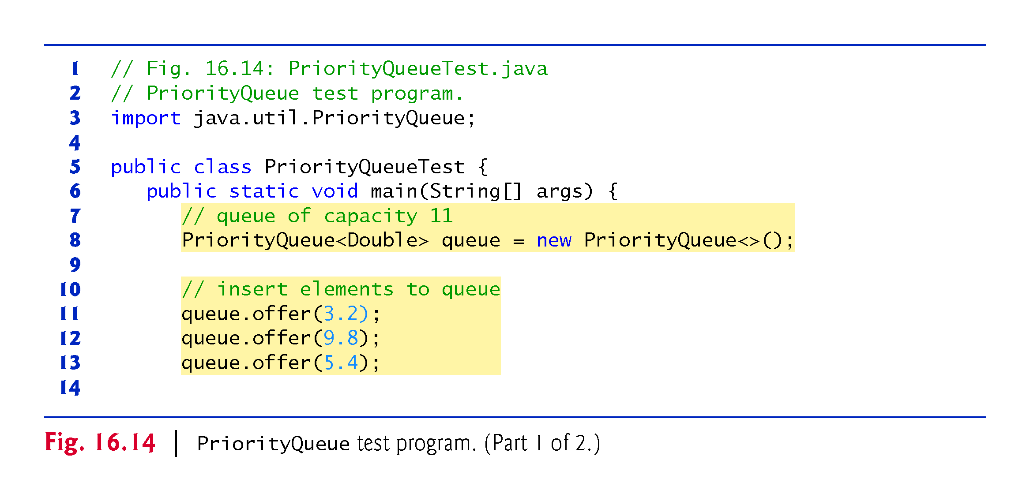

Slide 60
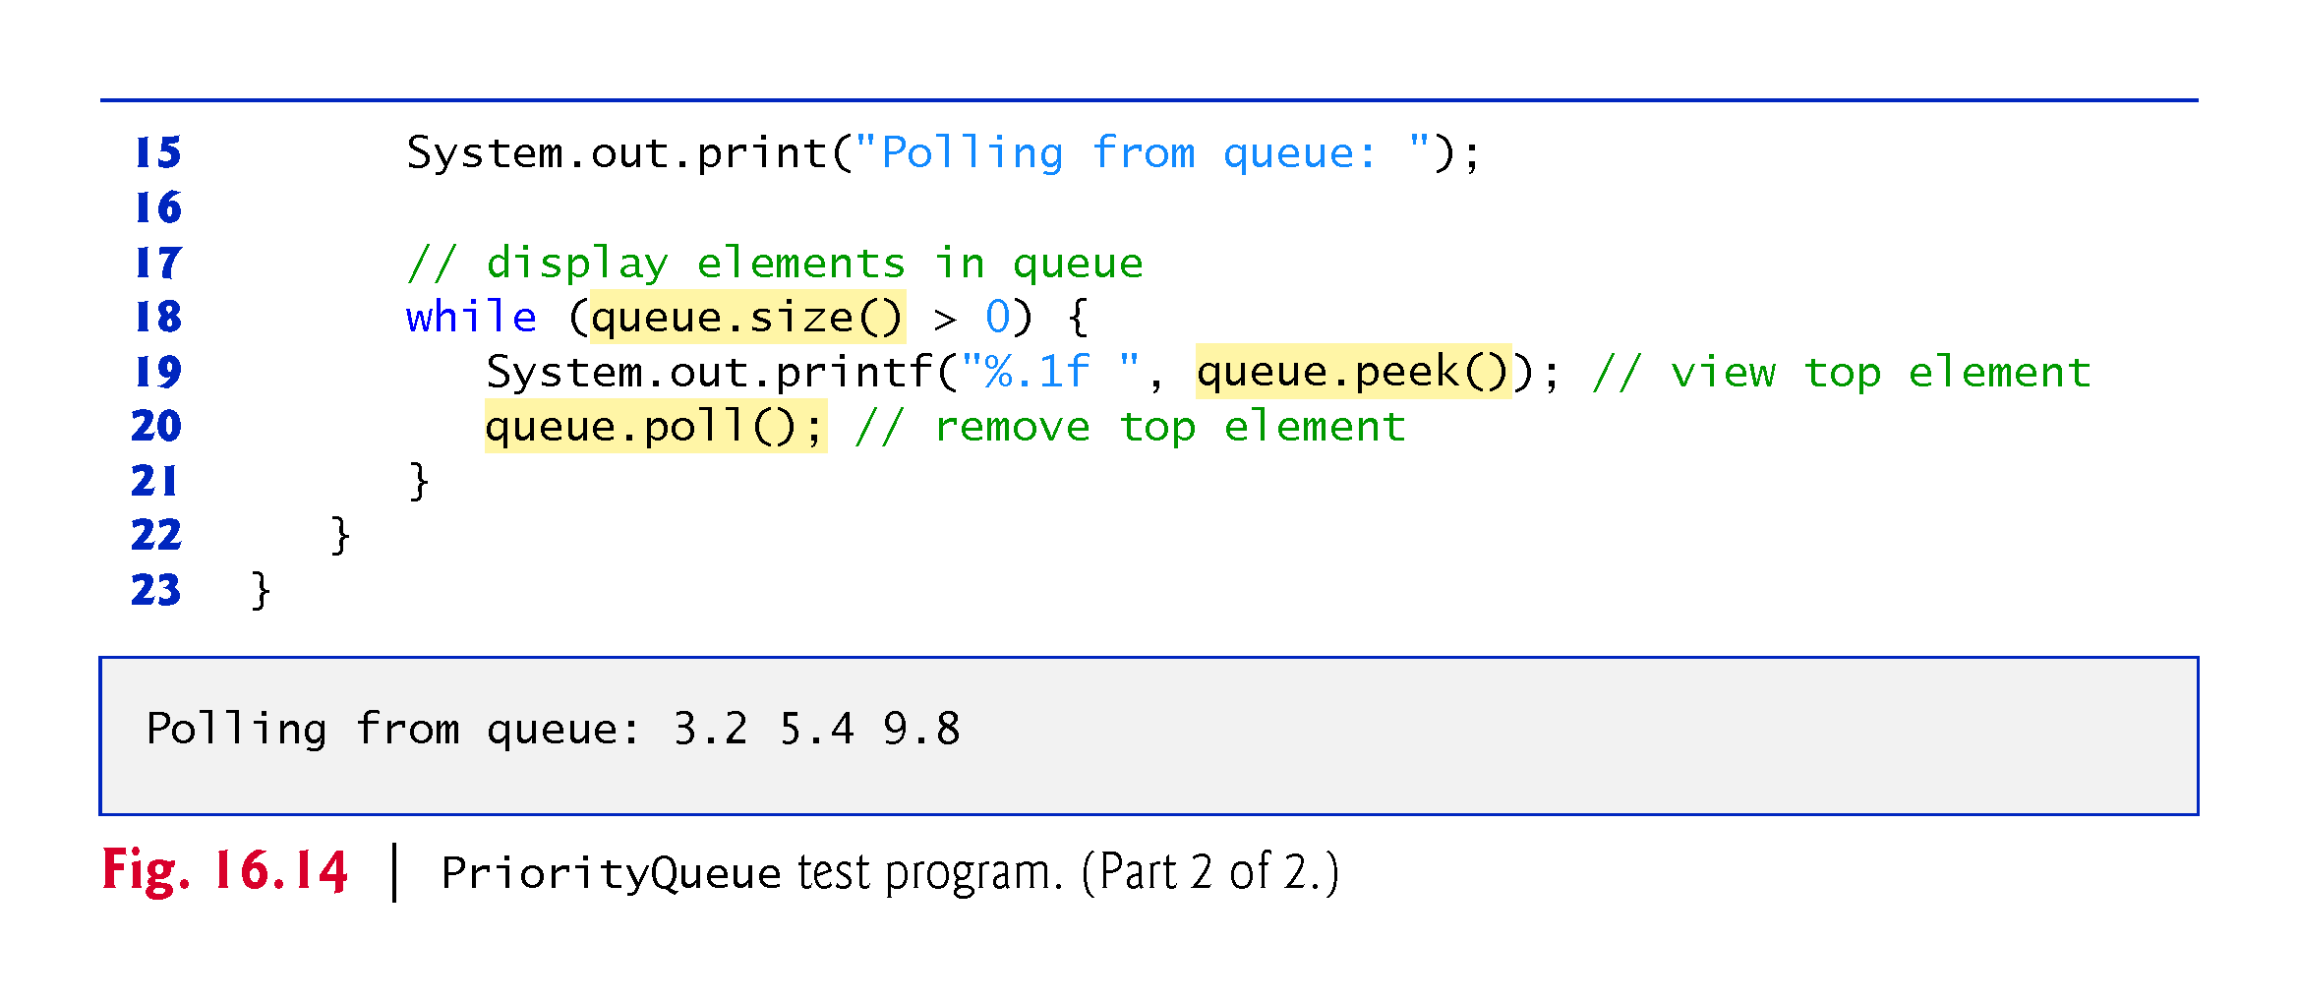

Slide 61
16.9 Sets
A Set is an unordered Collection of unique elements (i.e., no duplicates).
The collections framework contains several Set implementations, including HashSet and TreeSet.
HashSet stores its elements in a hash table, and TreeSet stores its elements in a tree.

Slide 62
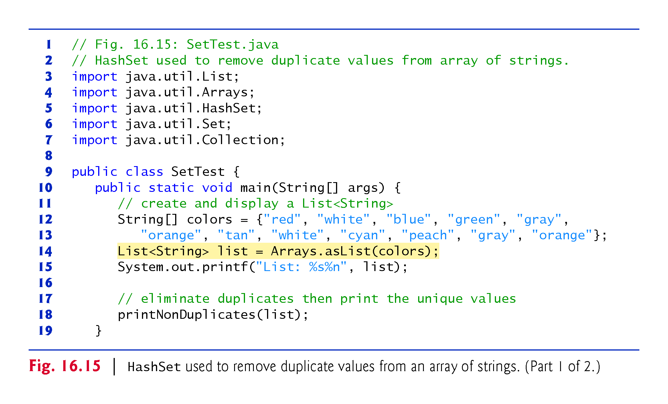

Slide 63
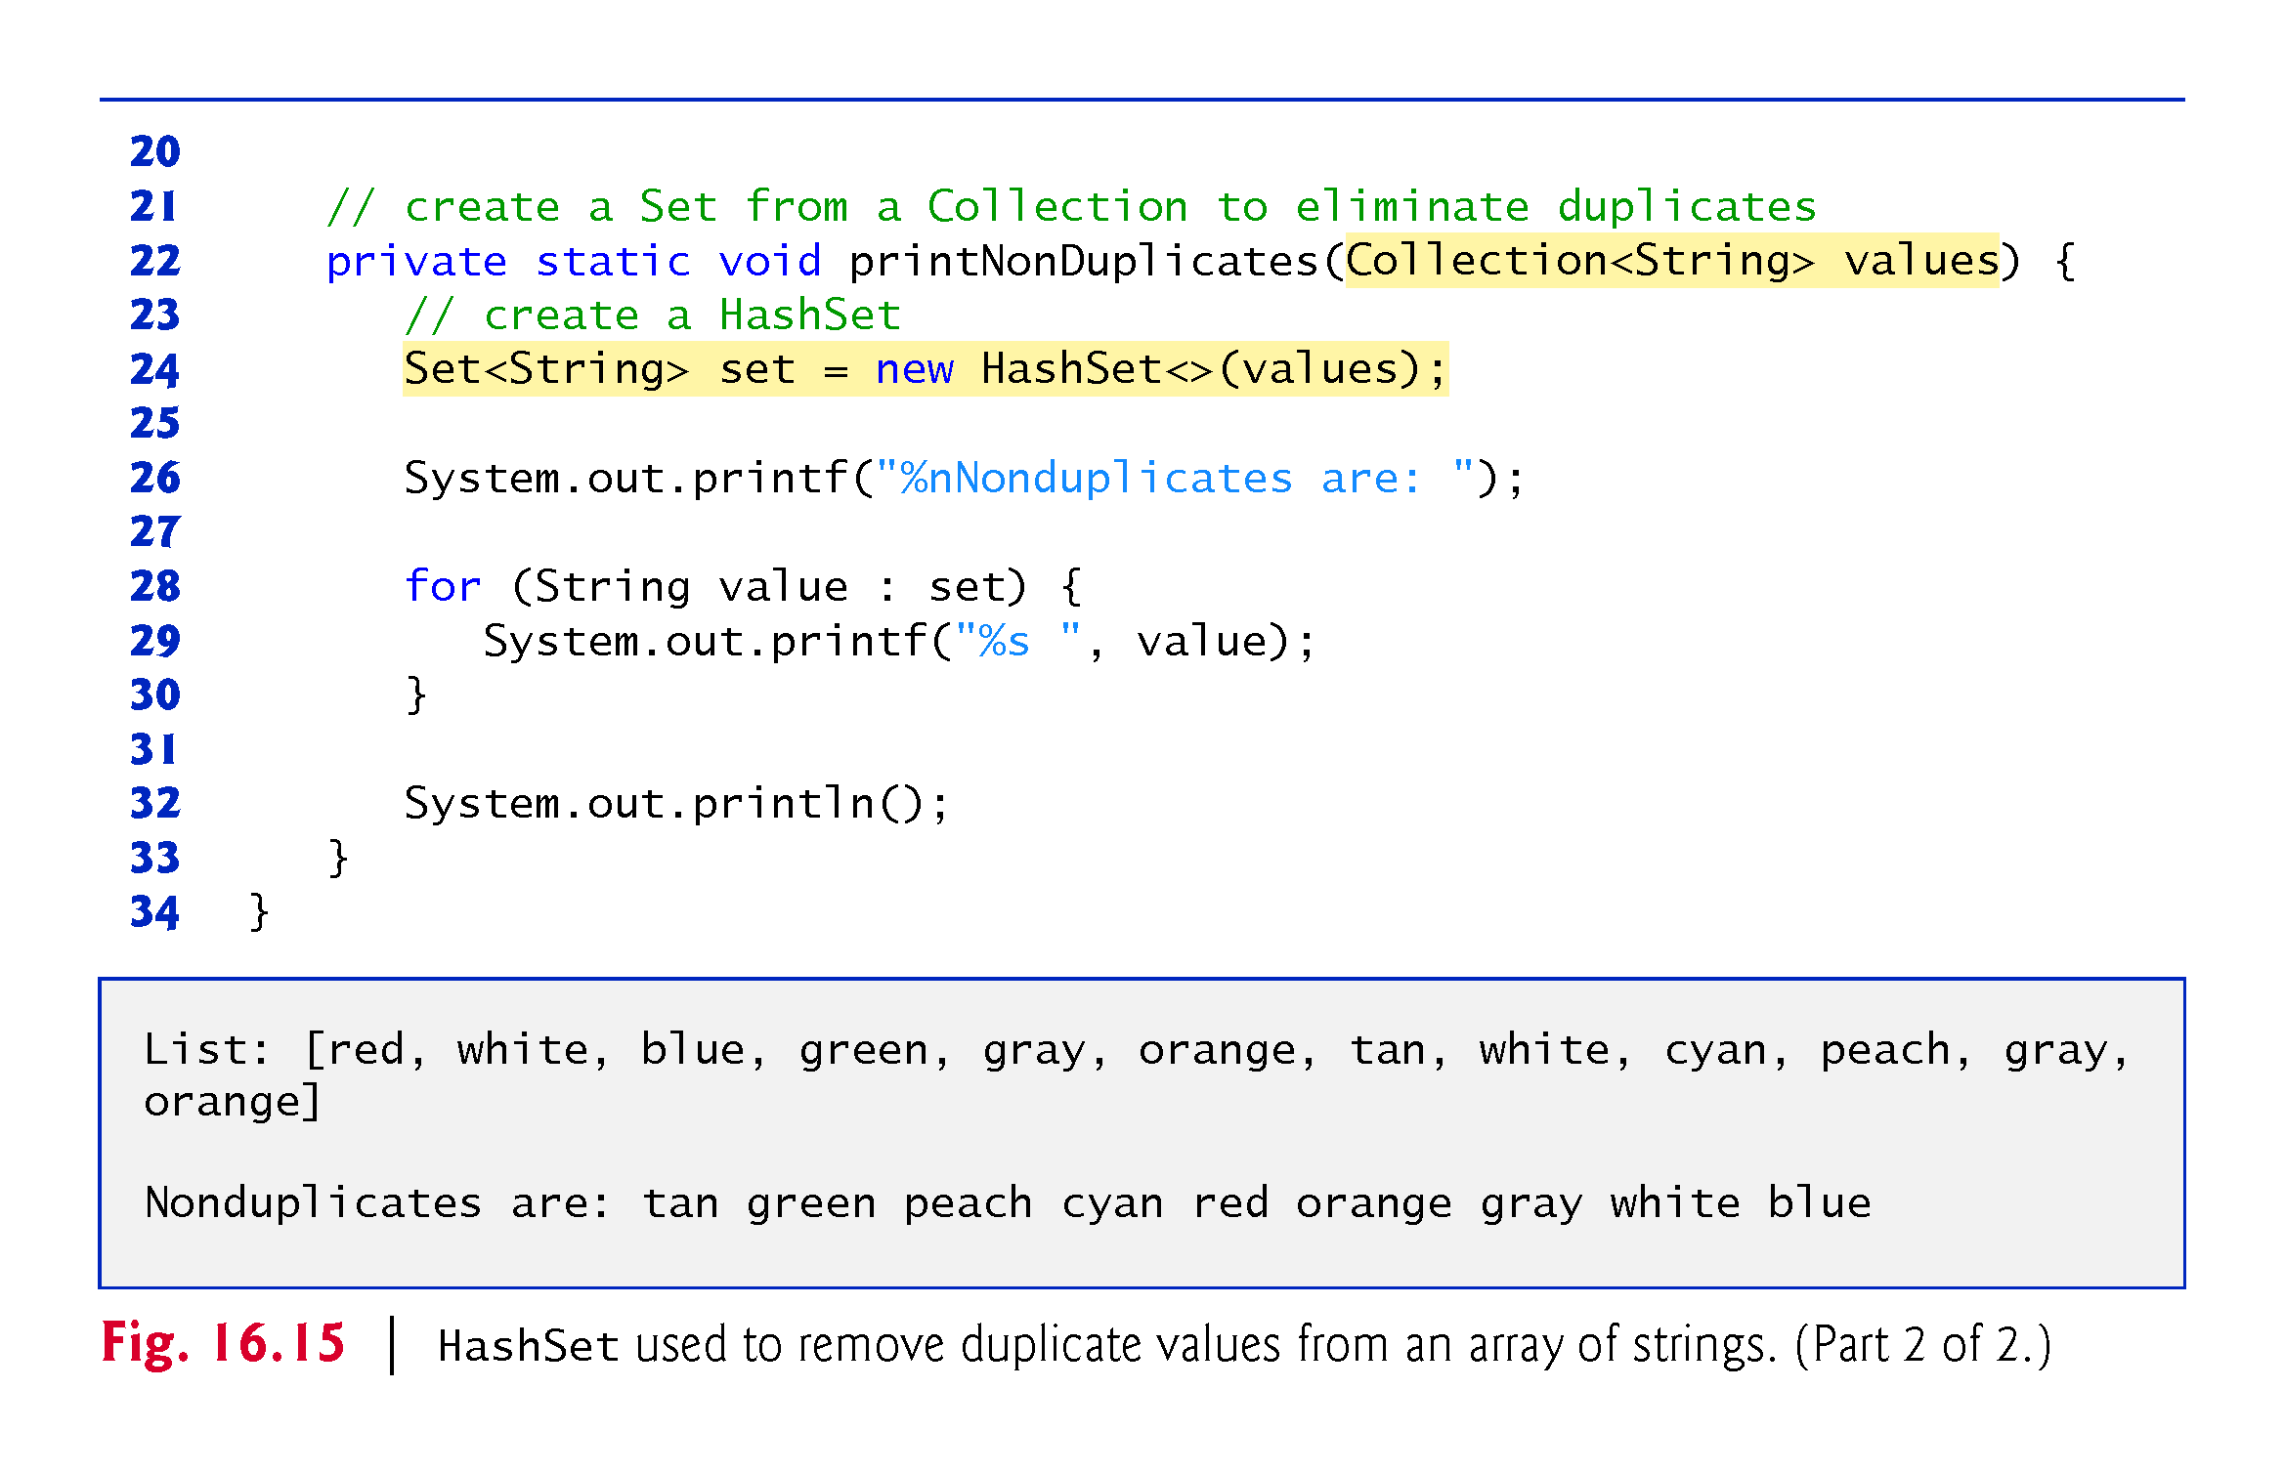

Slide 64
16.9 Sets (Cont.)
The collections framework also includes the SortedSet interface (which extends Set) for sets that maintain their elements in sorted order.
Class TreeSet implements SortedSet.
TreeSet method headSet gets a subset of the TreeSet in which every element is less than the specified value.
TreeSet method tailSet gets a subset in which each element is greater than or equal to the specified value.
SortedSet methods first and last get the smallest and largest elements of the set, respectively.

Slide 65
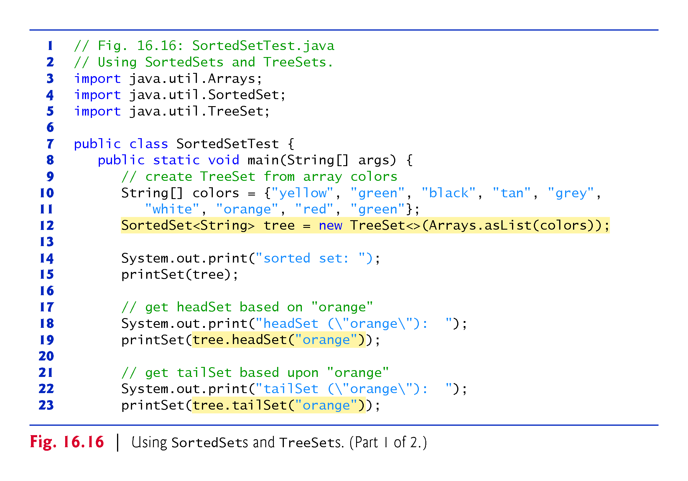

Slide 66
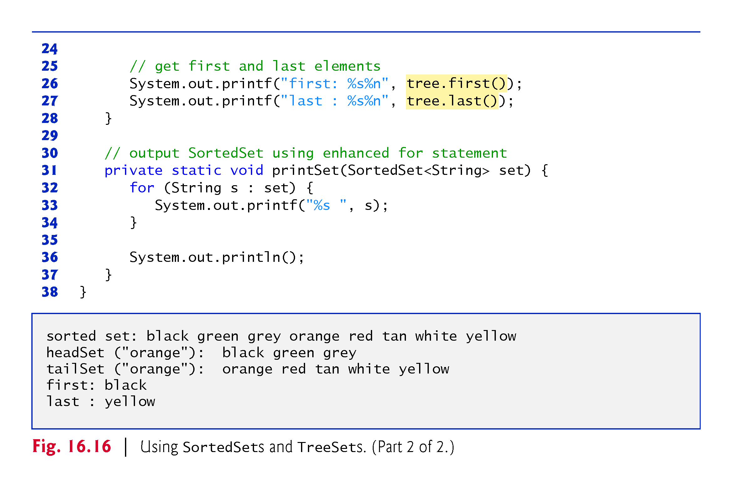

Slide 67
16.9 Maps
Maps associate keys to values.
The keys in a Map must be unique, but the associated values need not be.
If a Map contains both unique keys and unique values, it is said to implement a one-to-one mapping.
If only the keys are unique, the Map is said to implement a many-to-one mapping—many keys can map to one value.
Three of the several classes that implement interface Map are Hashtable, HashMap and TreeMap.
Hashtables and HashMaps store elements in hash tables, and TreeMaps store elements in trees.

Slide 68
16.9 Maps (Cont.)
Interface SortedMap extends Map and maintains its keys in sorted order—either the elements’ natural order or an order specified by a Comparator.
Class TreeMap implements SortedMap.
Hashing is a high-speed scheme for converting keys into unique array indices.
A hash table’s load factor affects the performance of hashing schemes.
The load factor is the ratio of the number of occupied cells in the hash table to the total number of cells in the hash table.
The closer this ratio gets to 1.0, the greater the chance of collisions.

Slide 69
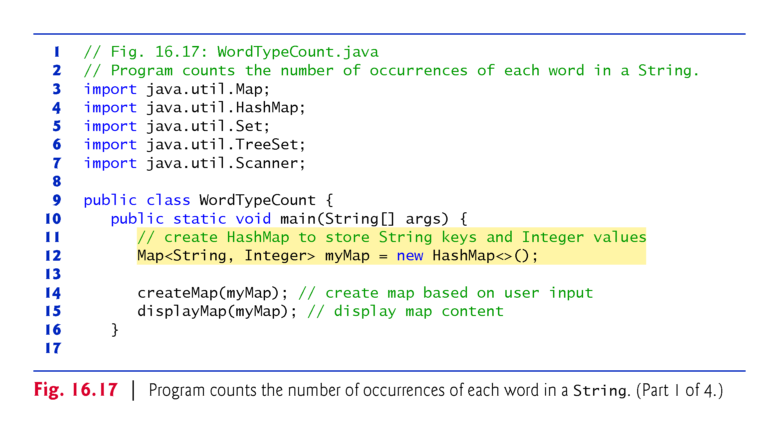

Slide 70
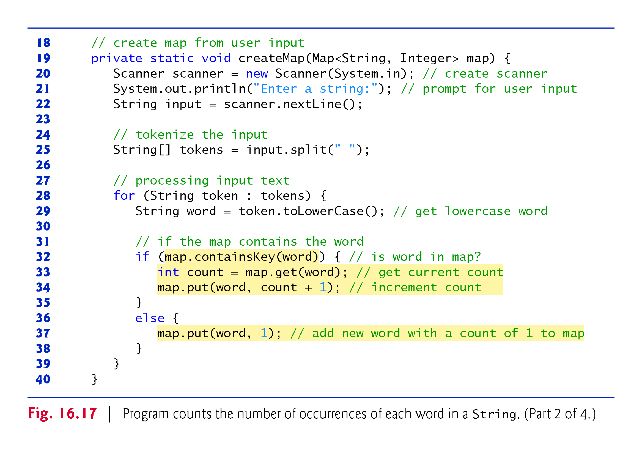

Slide 71
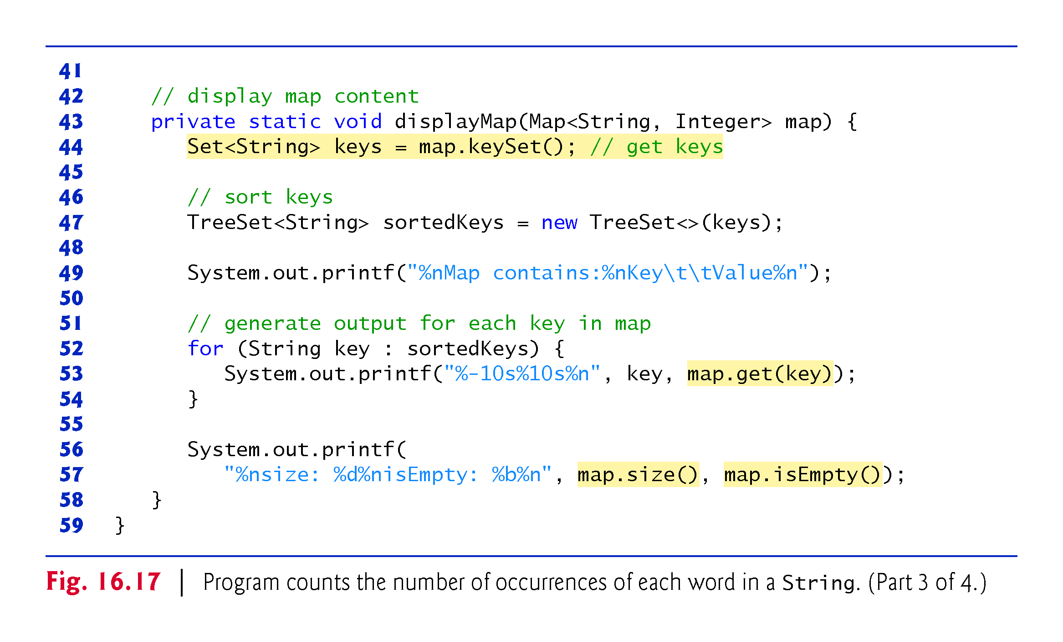

Slide 72
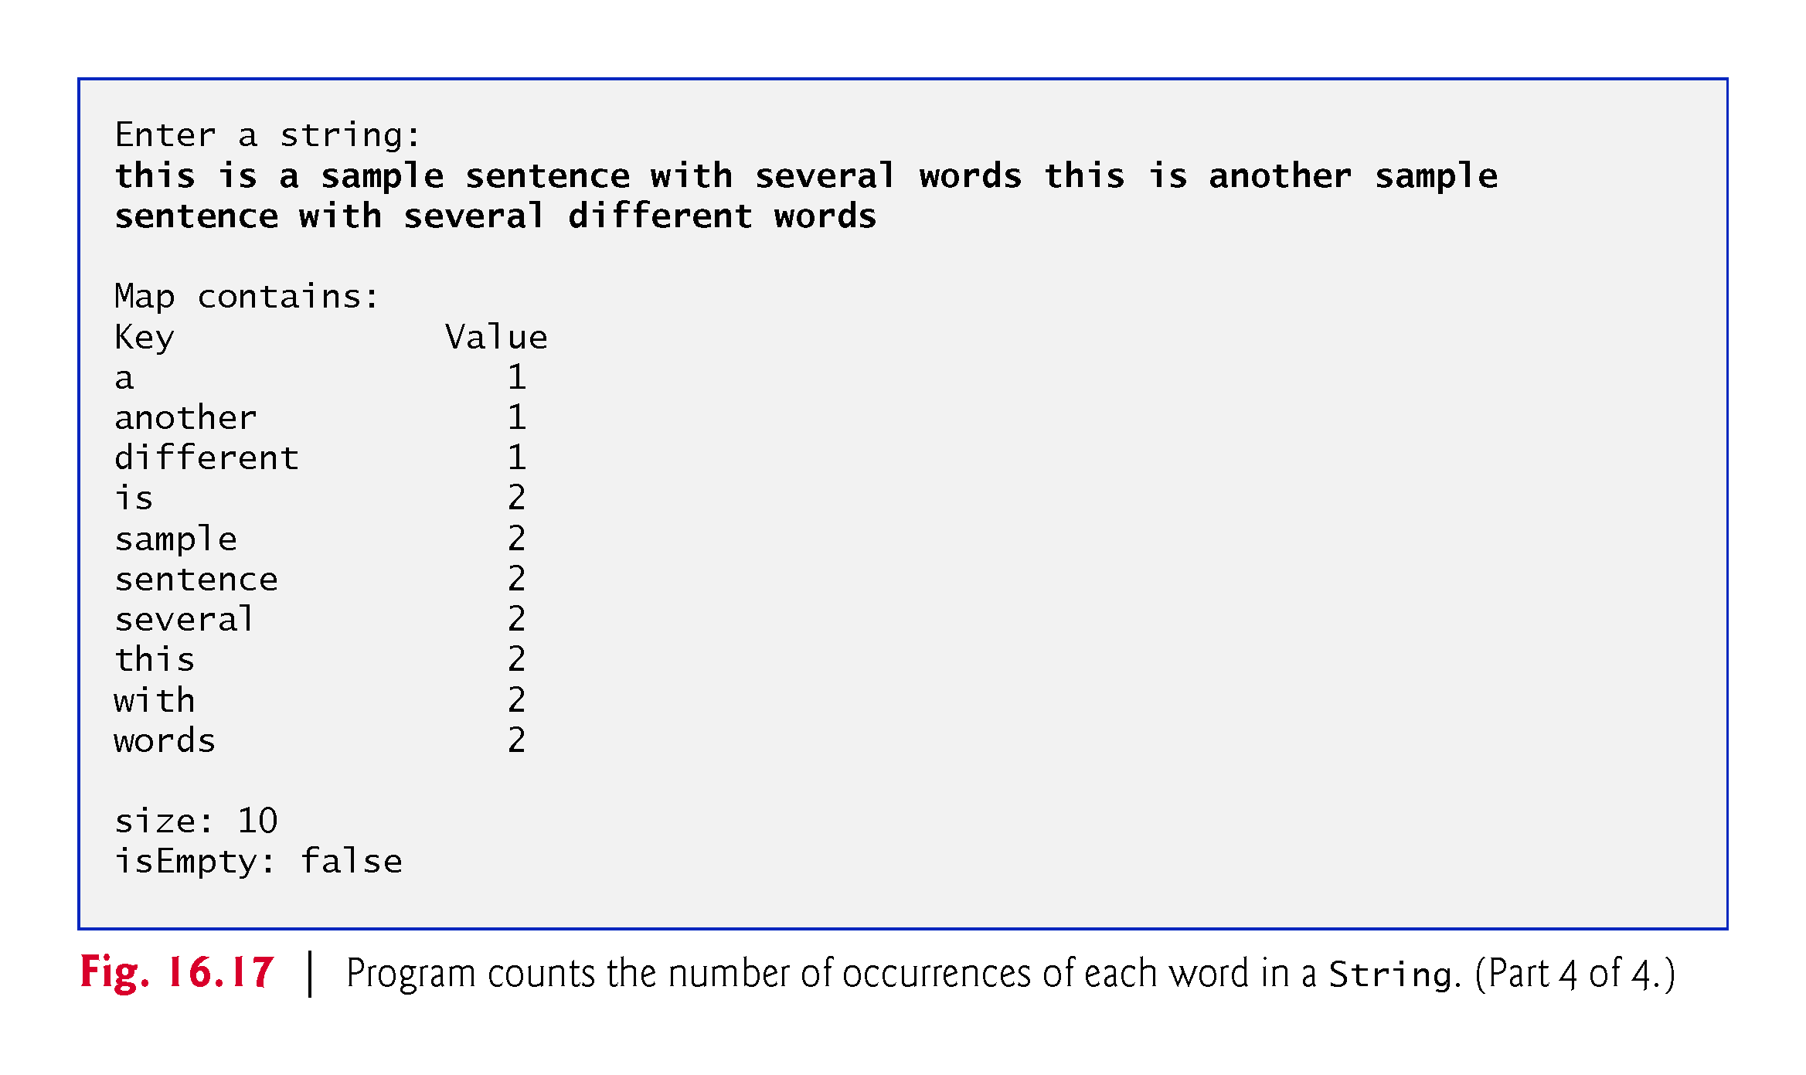

Slide 73
Chapter Objectives – What we covered
Describe what collections are.
Explain the class Arrays for array manipulations.
Describe the type-wrapper classes that enable programs to process primitive data values as objects.
Describe autoboxing and auto-unboxing.
Explain the prebuilt generic data structures from the collections framework.
Explain various algorithms of the Collections class.
Explain iterators to “walk through” a collection.

Slide 74
Questions?

